Slide 1
Ch 3 thoughts…

Slide 2
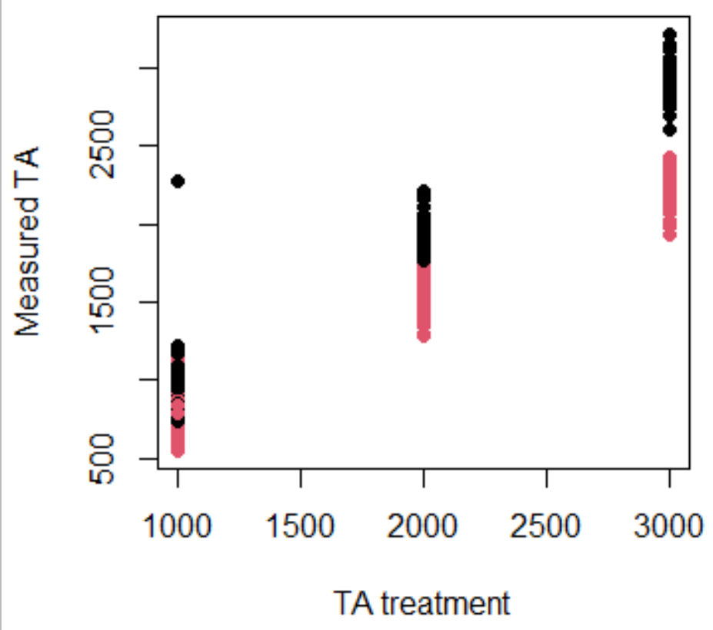
Treatments and sample sizes
Red (low S) and Black (amb S)
Treatments for measured TA vs targets do not necessarily overlap for all bins; if we run the data as a regression does it make more sense to look at each treatment separately?
If we do this, we are not able to compare the effect of S and TA, but are able to demonstrate the effect of TA at both high S and low S
For each of the colors, there are two treatment basins that were used; within each basin, there are between 35-45 individuals (some died/fell off/etc and so have been removed)

Slide 3
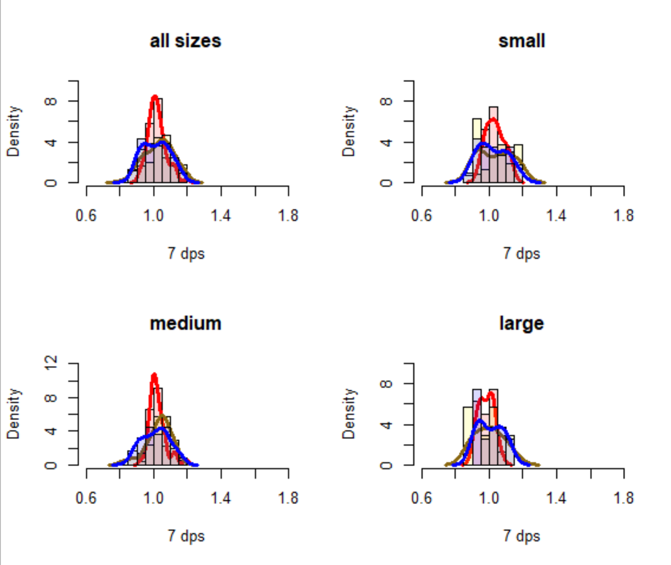
EFFECT OF SIZE AND ALKALINITY ON GROWTH RATIO AFTER 1 WEEK
TA treatment
1000
2000
3000
High salinity
Notes:
Observations:
Mean ratio between treatments and size groups appear similar and are centered around 1.0 (ie no overall growth), however, the distribution widths of the low TA and high TA are much wider, meaning outliers are less frequent than in mid TA treatment. To me, this means that the “shock effect” of high TA influx or depletion to TA (1000) are more variable than to control (2000).

Slide 4
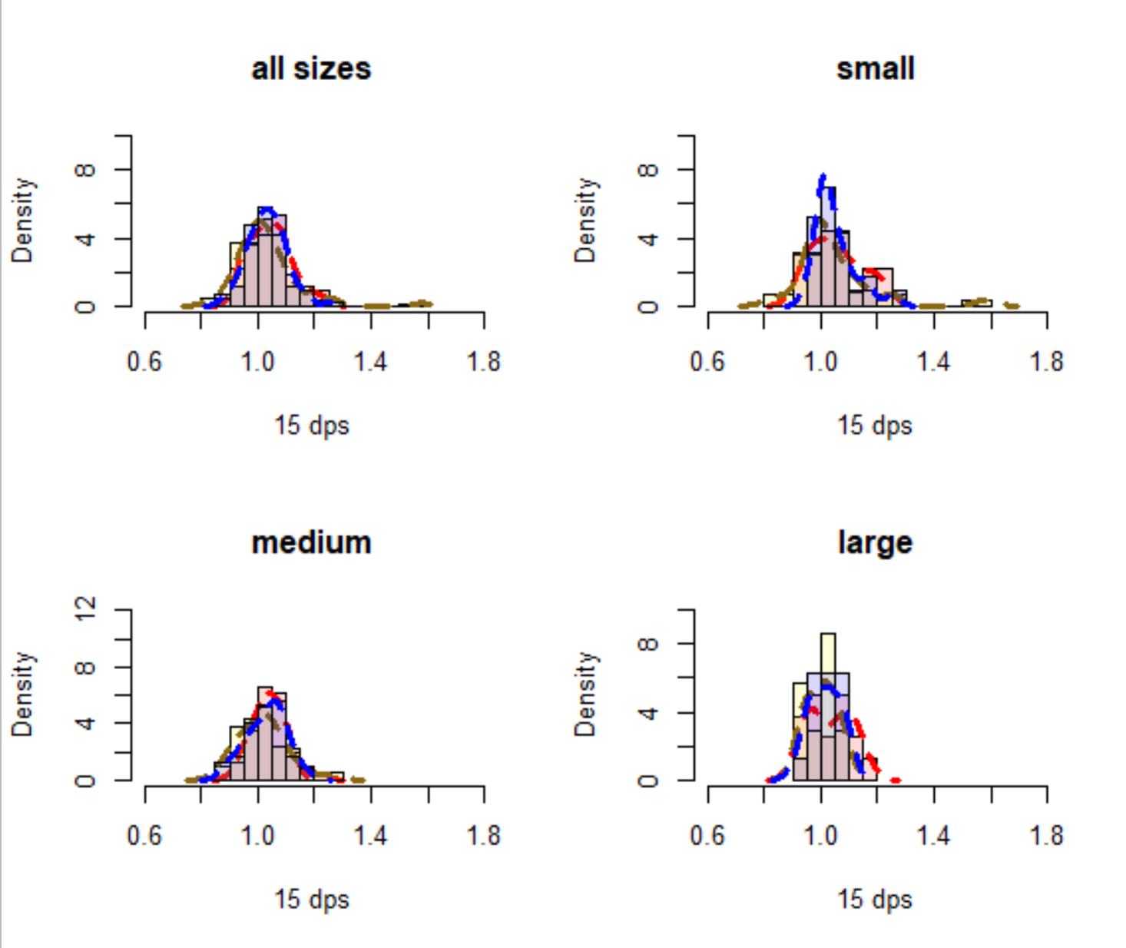
EFFECT OF SIZE AND ALKALINITY ON GROWTH RATIO AFTER 2 WEEKS
TA treatment
1000
2000
3000
High salinity
Notes:
Observations:
After two weeks, the distribution widths appear converge into a similar distribution among the TA treatments. This suggests that after 2 weeks time, the effect of increasing/decreasing TA has similar variability with a group of oysters. Mean growth ratio is also minorly shifted to the right, indicating that on average, net growth has occurred since week 1, though there are individuals from each treatment that showed reductions in size (ie net dissolution). To me, this indicated that after two weeks, individuals have acclimated to each of the TA treatments, such that, there is no difference in growth ratio among the three TA levels.

Slide 5
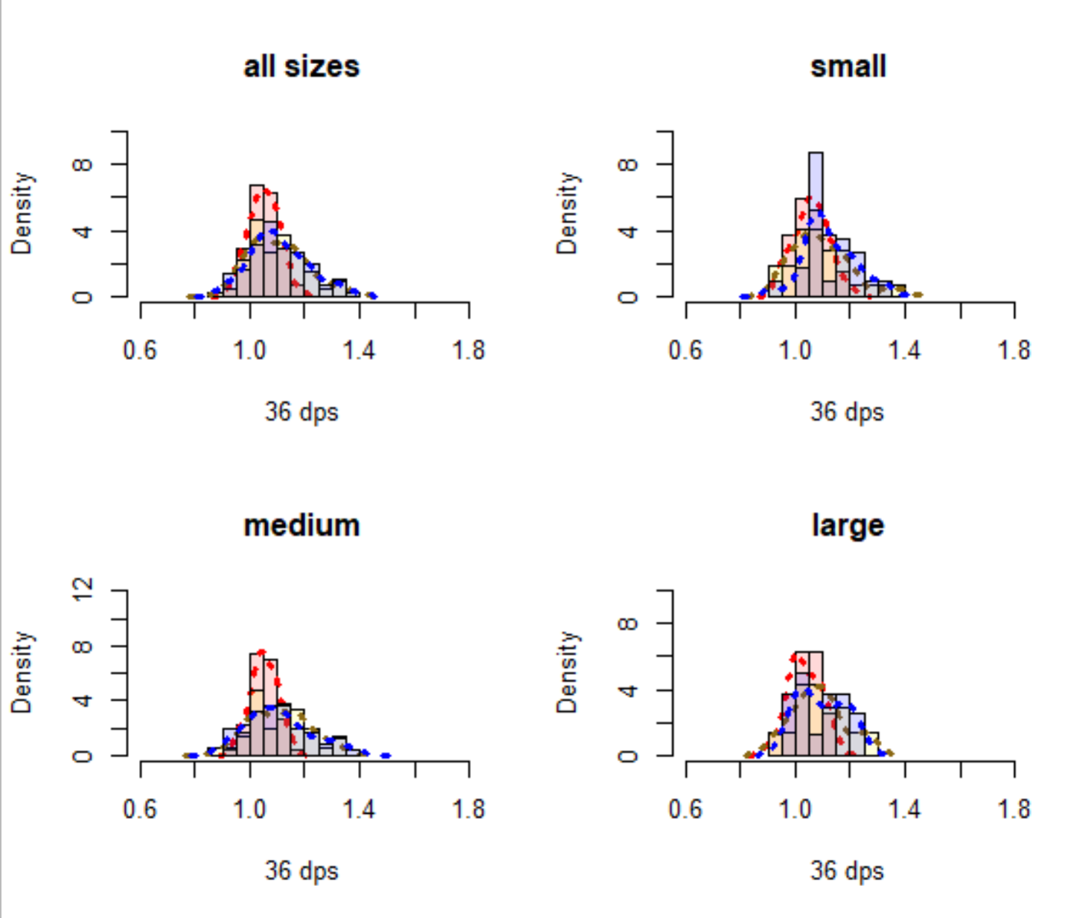
EFFECT OF SIZE AND ALKALINITY ON GROWTH RATIO AFTER 5 WEEKS
TA treatment
1000
2000
3000
High salinity
Notes:
Observations:
After five weeks, the distribution widths in the high and low TA treatments are much flatter, meaning that overall, changing the TA treatment has higher consequences for the variability in response from individuals than in historically grown conditions. On average, at high salinity, the effect of TA does not seem to be strong after 5 weeks of growing, but as the mean value is shifted to the right, individuals did indeed grow. Thus, individuals grown in high Salinity environments may show more variability to initial changing carbonate chemistry, but that shock does not propagate into average growth rates by the time they are acclimated. However, individual growth rate variability increases post acclimation over time, suggesting historical exposure to amb conditions as a possible explanation… (slowly individual performance becomes more variable again?).

Slide 6
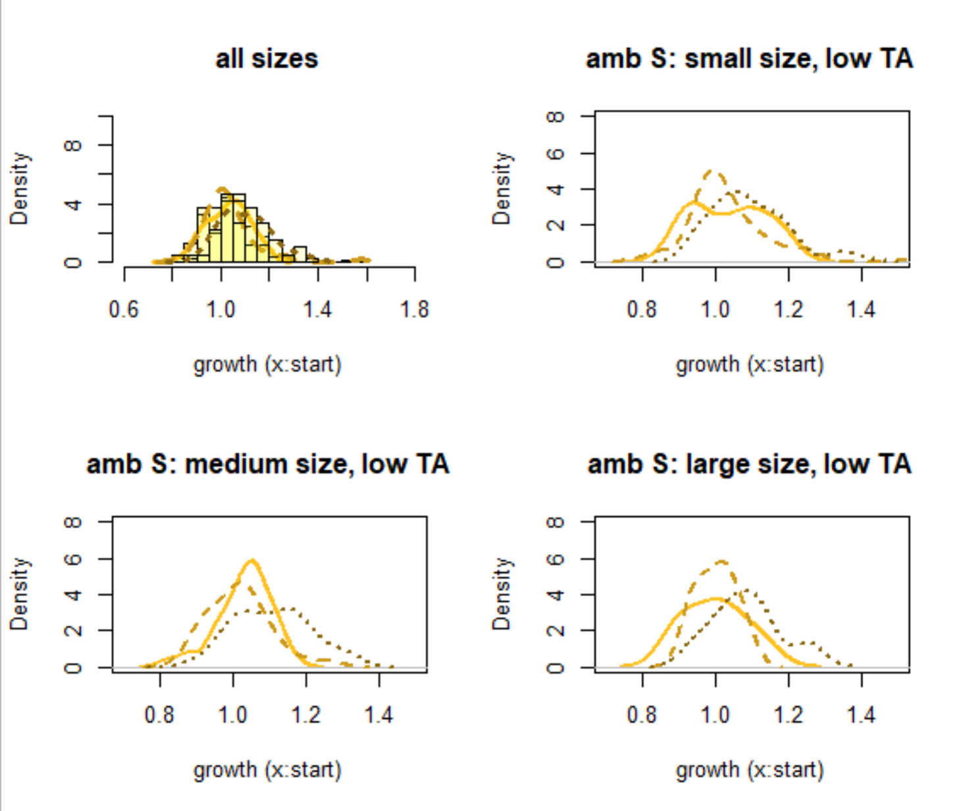
EFFECT OF TIME ON GROWTH RATIO (ACCLIMATION DIFFERENCES) WITHIN EACH TREATMENT/SIZE GROUP
TA treatment
1000
2000
3000
1 week
2 weeks
5 weeks
High salinity
Notes:
maybe slightly bigger in last week
Slow and small acclimation

Slide 7
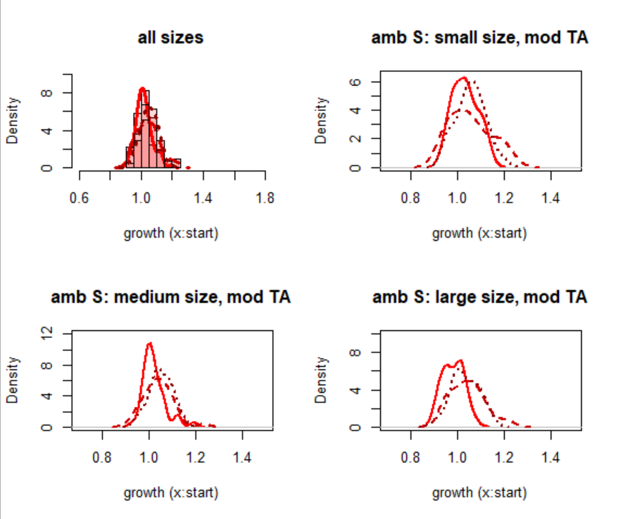
EFFECT OF TIME ON GROWTH RATIO (ACCLIMATION DIFFERENCES) WITHIN EACH TREATMENT/SIZE GROUP
TA treatment
2000
1 week
2 weeks
5 weeks
High salinity
Notes:
Slightly bigger after 2 weeks but no diff to week 3
Fast but minimal acclimation

Slide 8
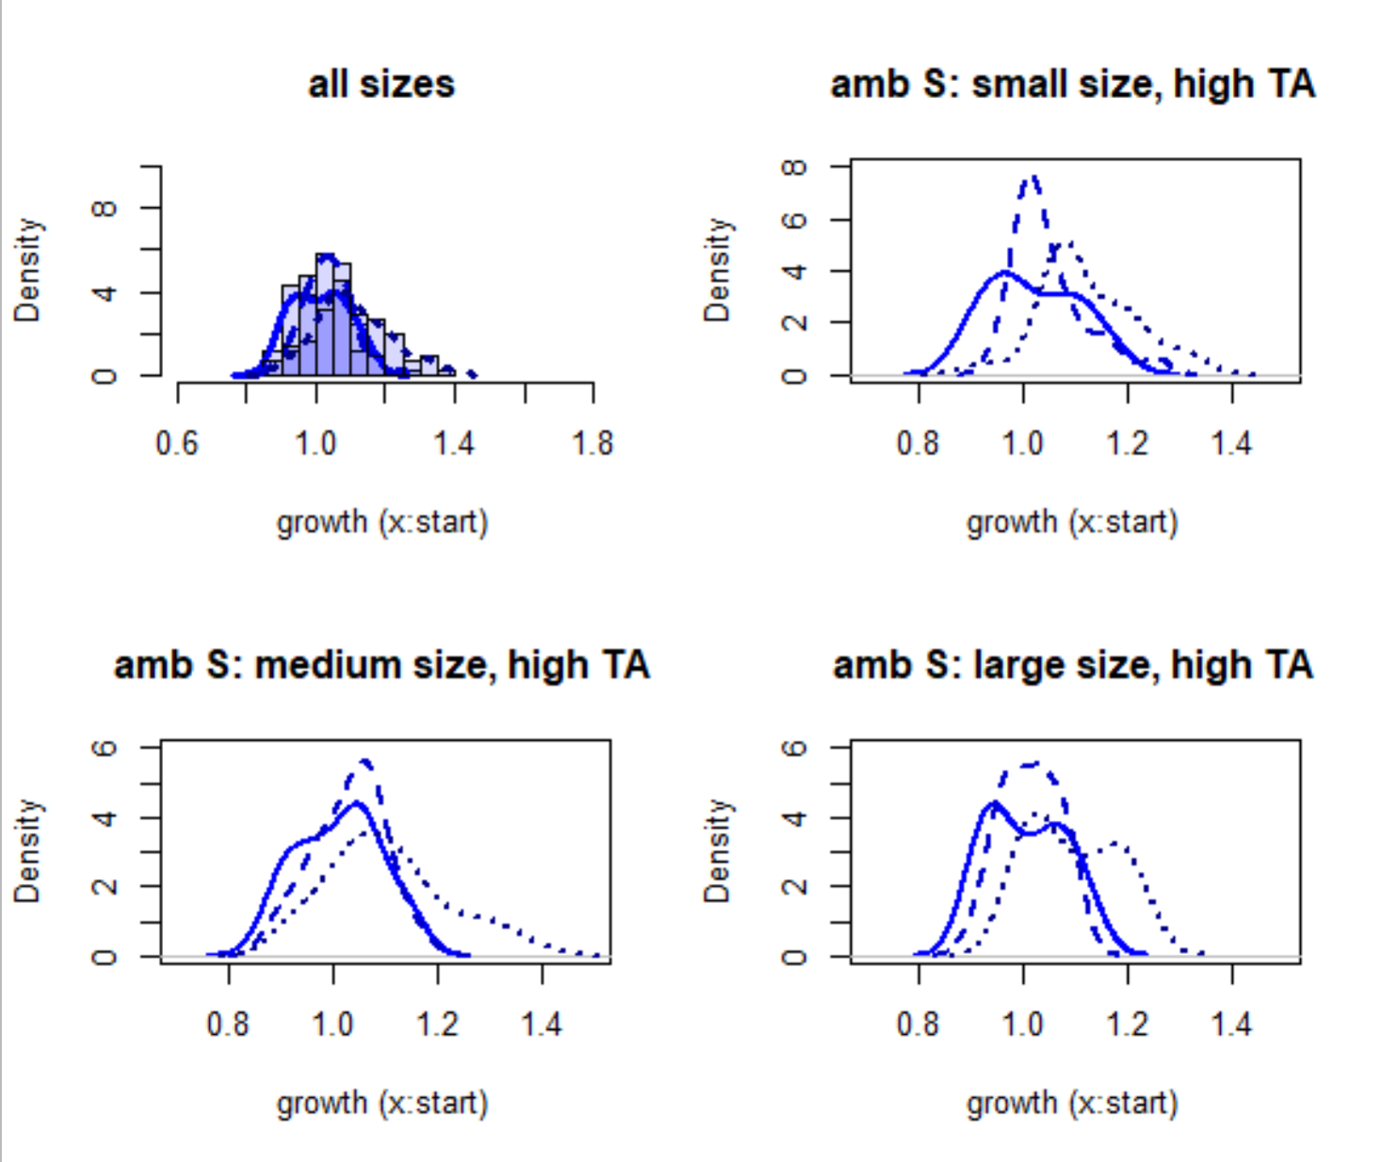
EFFECT OF TIME ON GROWTH RATIO (ACCLIMATION DIFFERENCES) WITHIN EACH TREATMENT/SIZE GROUP
TA treatment
3000
1 week
2 weeks
5 weeks
High salinity
Notes:
Looks like steady increase in r=growth ratio (but maybe mid time doesn’t differ from either?
Slow acclimation; second biggest shifts in growth

Slide 9
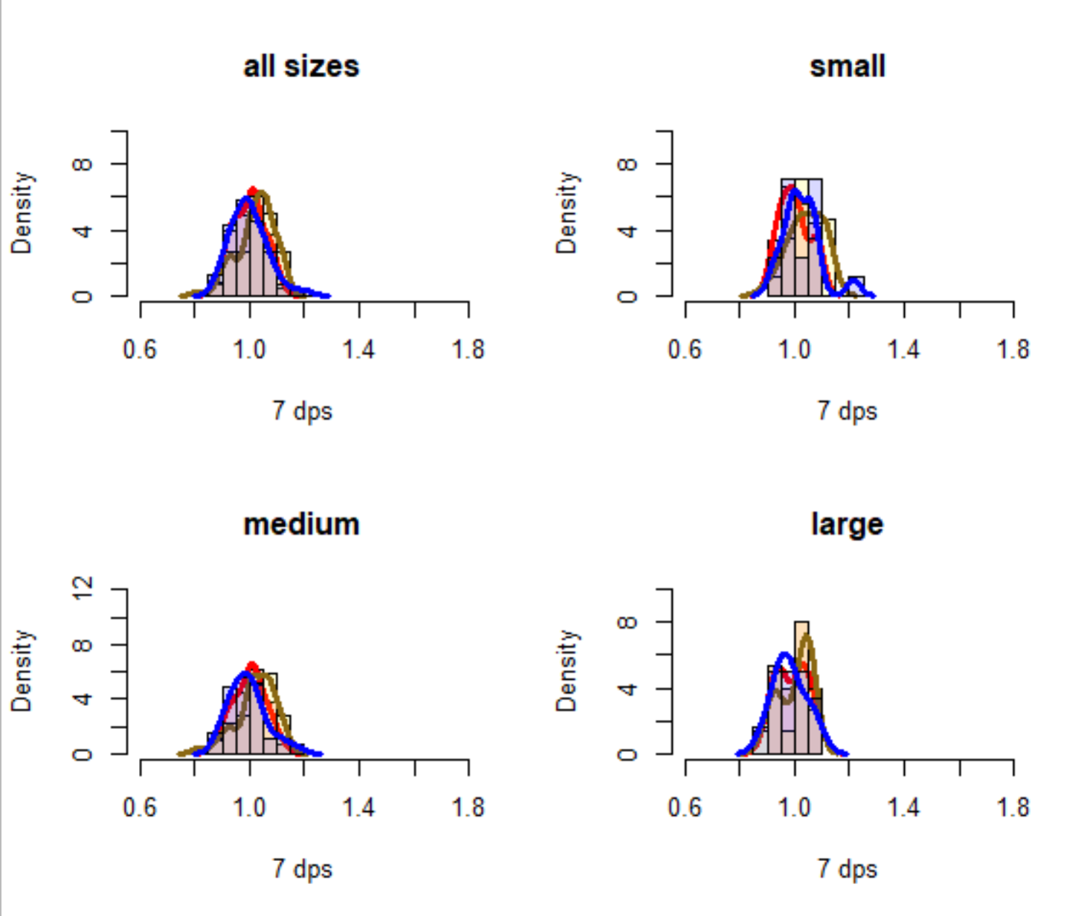
EFFECT OF SIZE AND ALKALINITY ON GROWTH RATIO AFTER 1 WEEK
TA treatment
1000
2000
3000
Low salinity
Notes:
Observations:
Mean ratio between treatments and size groups appear similar and are centered around 1.0 (ie no overall growth), and variability among individuals within a treatment is also similar. To me, this seems like the “shock effect” of altered TA (and a combined low S shock) similarly impacts individuals.

Slide 10
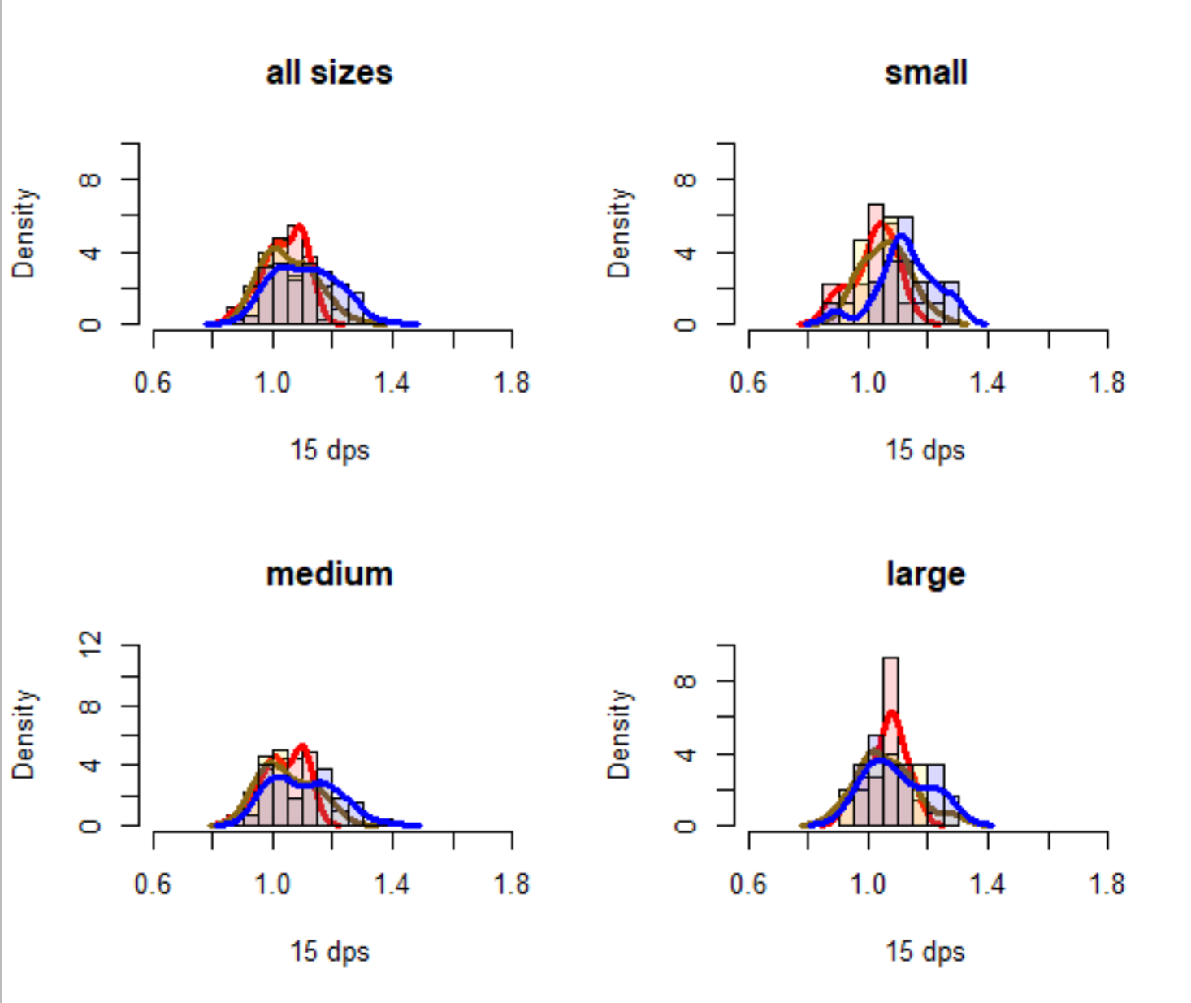
EFFECT OF SIZE AND ALKALINITY ON GROWTH RATIO AFTER 2 WEEKS
TA treatment
1000
2000
3000
Low salinity
Notes:
Observations:
After two weeks, the distribution widths appear to widen for the high TA treatment but remain similar in low and ambient TA conditions, meaning that the frequency of growth outliers is higher in low and ambient TA. Mean growth may subtly be shifted to the right between low and high TA, however, ambient TA doesn’t appear to differ from either. To me, this means that relative to 1 week patterns, individuals are not acclimating to changing TA in the same way under low S conditions. Low and high TA exposed individuals have higher variability in growth relative to mid TA.

Slide 11
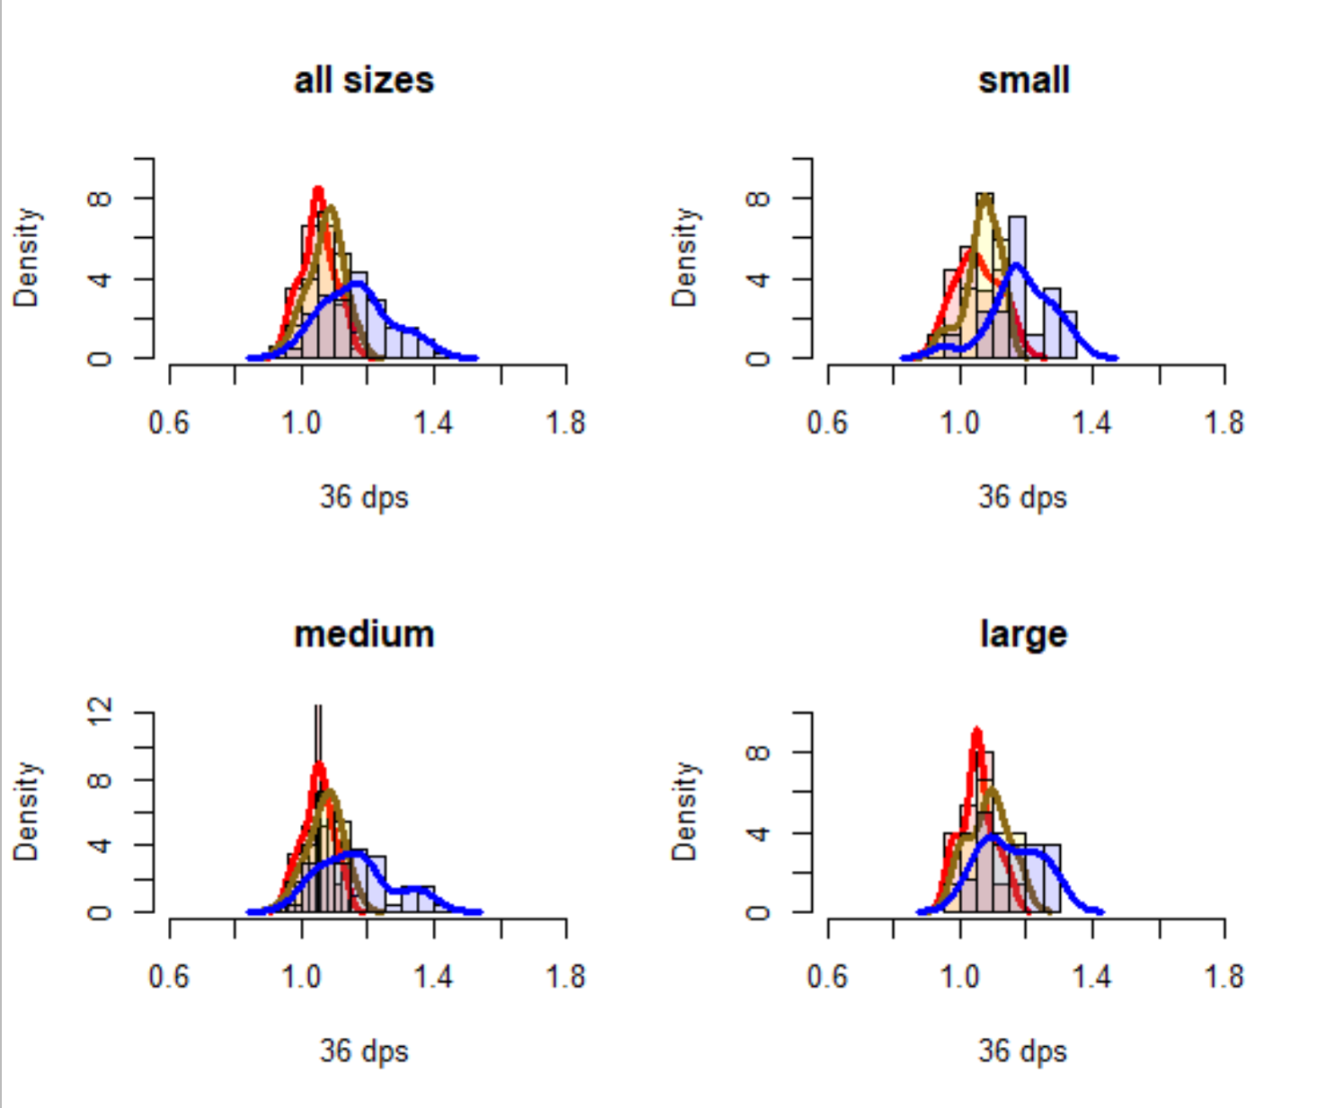
EFFECT OF SIZE AND ALKALINITY ON GROWTH RATIO AFTER 5 WEEKS
TA treatment
1000
2000
3000
Low salinity
Notes:
Observations:
After 5 weeks of growth, the distribution widths from the acclimation point narrow for low and moderate TA treatments but remain wide in high TA treatment. This suggests low and mid TA exposed individuals converge on a similar growth rate. High TA treatments show a right-shifted (ie increased growth ratio) and an even more flattened distribution. To me this suggests that relative to the two lower TA treatments, the acclimation to high TA results on an average growth rate increase (relative to the other two), but that there is less convergence on a similar growth rate amongst individuals.
may take longer for some, but for those who are able to acclimate, they are able to have much larger growth ratios.

Slide 12
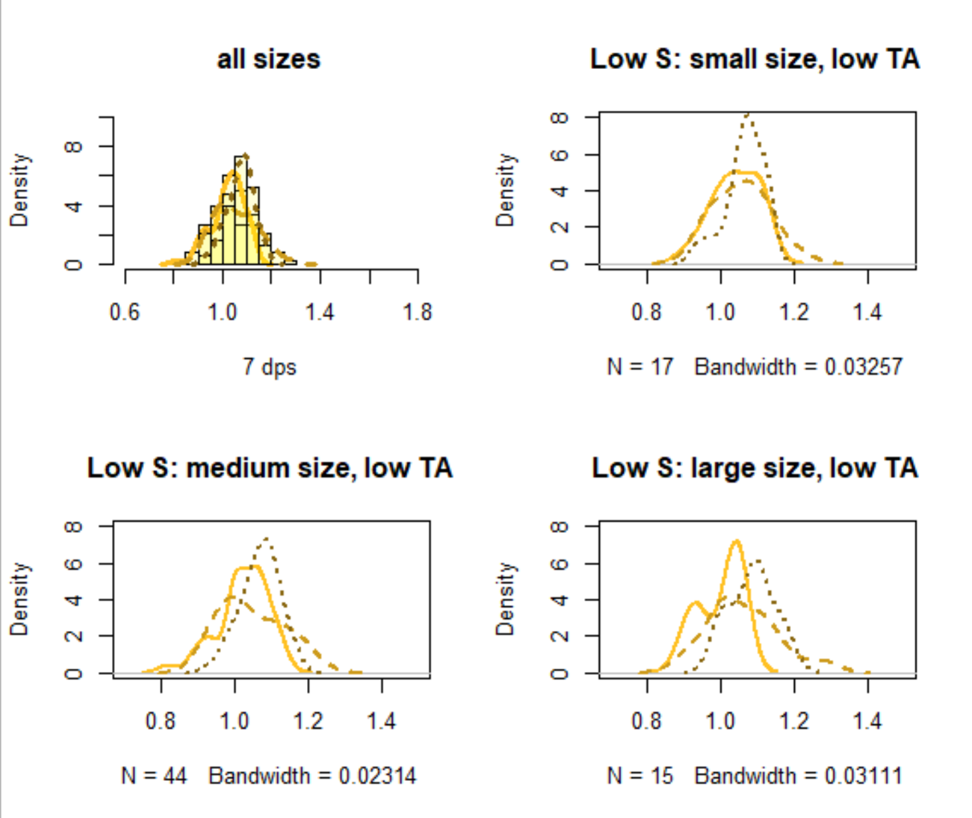
EFFECT OF TIME ON GROWTH RATIO (ACCLIMATION DIFFERENCES) WITHIN EACH TREATMENT/SIZE GROUP
TA treatment
1000
2000
3000
1 week
2 weeks
5 weeks
Low salinity
Notes:
Possible shift to the right on the last week?
Slow acclimation; very small shift

Slide 13
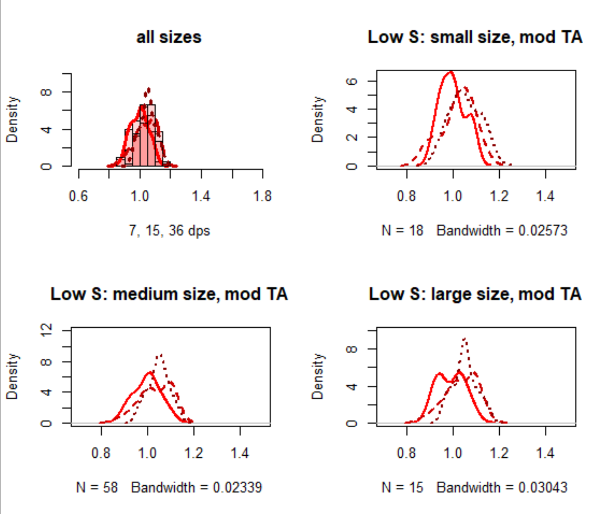
EFFECT OF TIME ON GROWTH RATIO (ACCLIMATION DIFFERENCES) WITHIN EACH TREATMENT/SIZE GROUP
TA treatment
2000
1 week
2 weeks
5 weeks
Low salinity
Notes:
Possible shift to the rig
Fast acclimation (but small)
ht on week 2 but then no difference in week 5 from 2

Slide 14
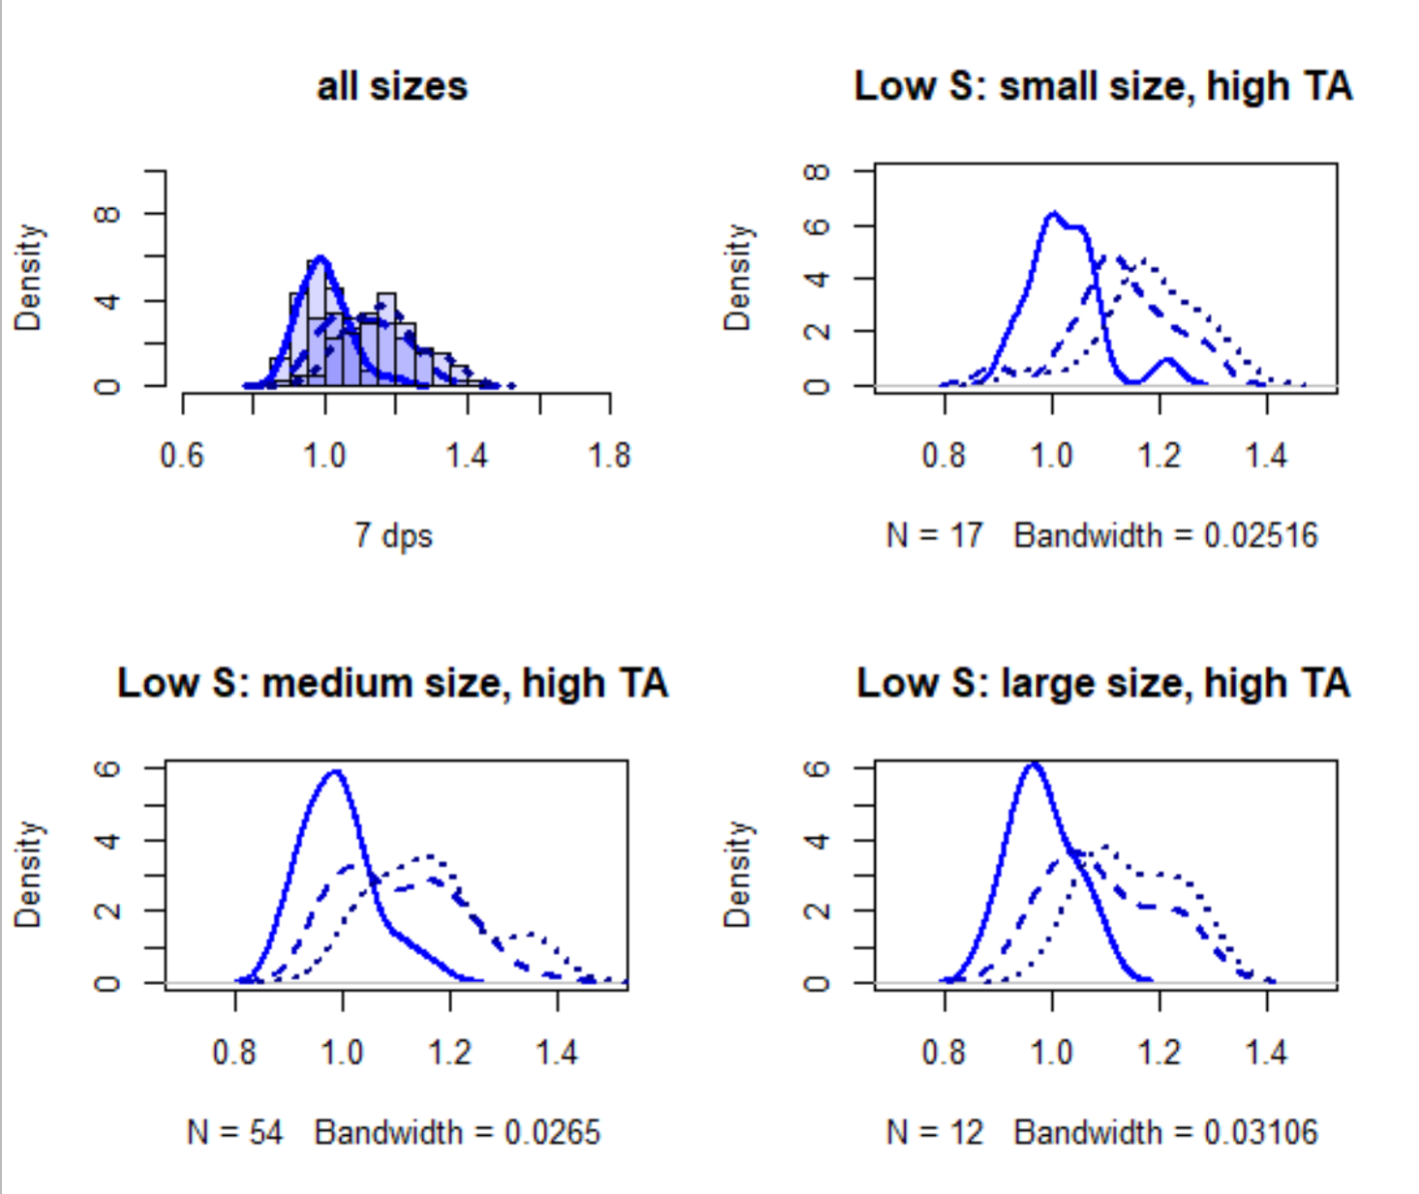
EFFECT OF TIME ON GROWTH RATIO (ACCLIMATION DIFFERENCES) WITHIN EACH TREATMENT/SIZE GROUP
TA treatment
3000
1 week
2 weeks
5 weeks
Low salinity
Notes:
Larger growth rate shift from week 1 to week 2 than in other treatments, almost no change from week 2 to week 5
Fast acclimation

Slide 15
Acclimation Speeds + amounts by treatment
 | Acclimation speed
Degree of growth change? | Fast (change from week 1 to 2, and then no change from week 2 to week 5) | Slow (change from week 1 to 2 and from 2 to 5)
Large shift in average growth ratio | Low S, High TA | High S, High TA
Minimal shift in average growth ratio | High S, Moderate TA Low S, Moderate TA | High S, Low TA Low S, Low TA

Slide 16
Acclimation speed
Big,
slow
Big,
fast
Inc. [TA]
Inc. Salinity
Degree of change
Small, slow
Small, fast

Slide 17
Here, it appears that TA may be a factor for driving large increases in growth (relative to salinity/pH); however, when it comes to acclimation speed, we see more variable patterns. This could stem from a multitude of reasons. It is unsurprising that high TA exposed individuals showed the largest shifts in average growth ratios. Due to HCO3- being used as a substrate, a higher concentration of bicarbonate may elevate the growth rates. However, at high salinity the acclimation speed to increased TA was much slower in ambient salinity seawater than in low salinity, where the acclimation was complete by the second week and didn’t change much after then. This suggests that although TA drives the degree of growth, individuals exposed to the multitude of stressors demonstrated faster physiological acclimation rates than those exposed to only a single axes of stress. What would drive this?
We saw minimal shifts from both moderate (control) and low TA treatments, whereas the moderate TA individuals showed faster acclimation than the low TA individuals. As we saw both high and low salinity treated individuals with fast and slow acclimations, this suggests that TA may have a larger impact than salinity at dictating acclimation speeds.
Individuals in ambient TA can quickly acclimate to low S conditions and high S control
Individuals in low TA are slow to acclimate to either S condition; compounding a second stressor does not change the stress of TA.

Slide 18
Some questions to discuss…
No large differences between size class of the individual (individuals remained in size class based on starting size)…does it make more sense to base the size classes on the surface area from t-1 ?

Slide 19
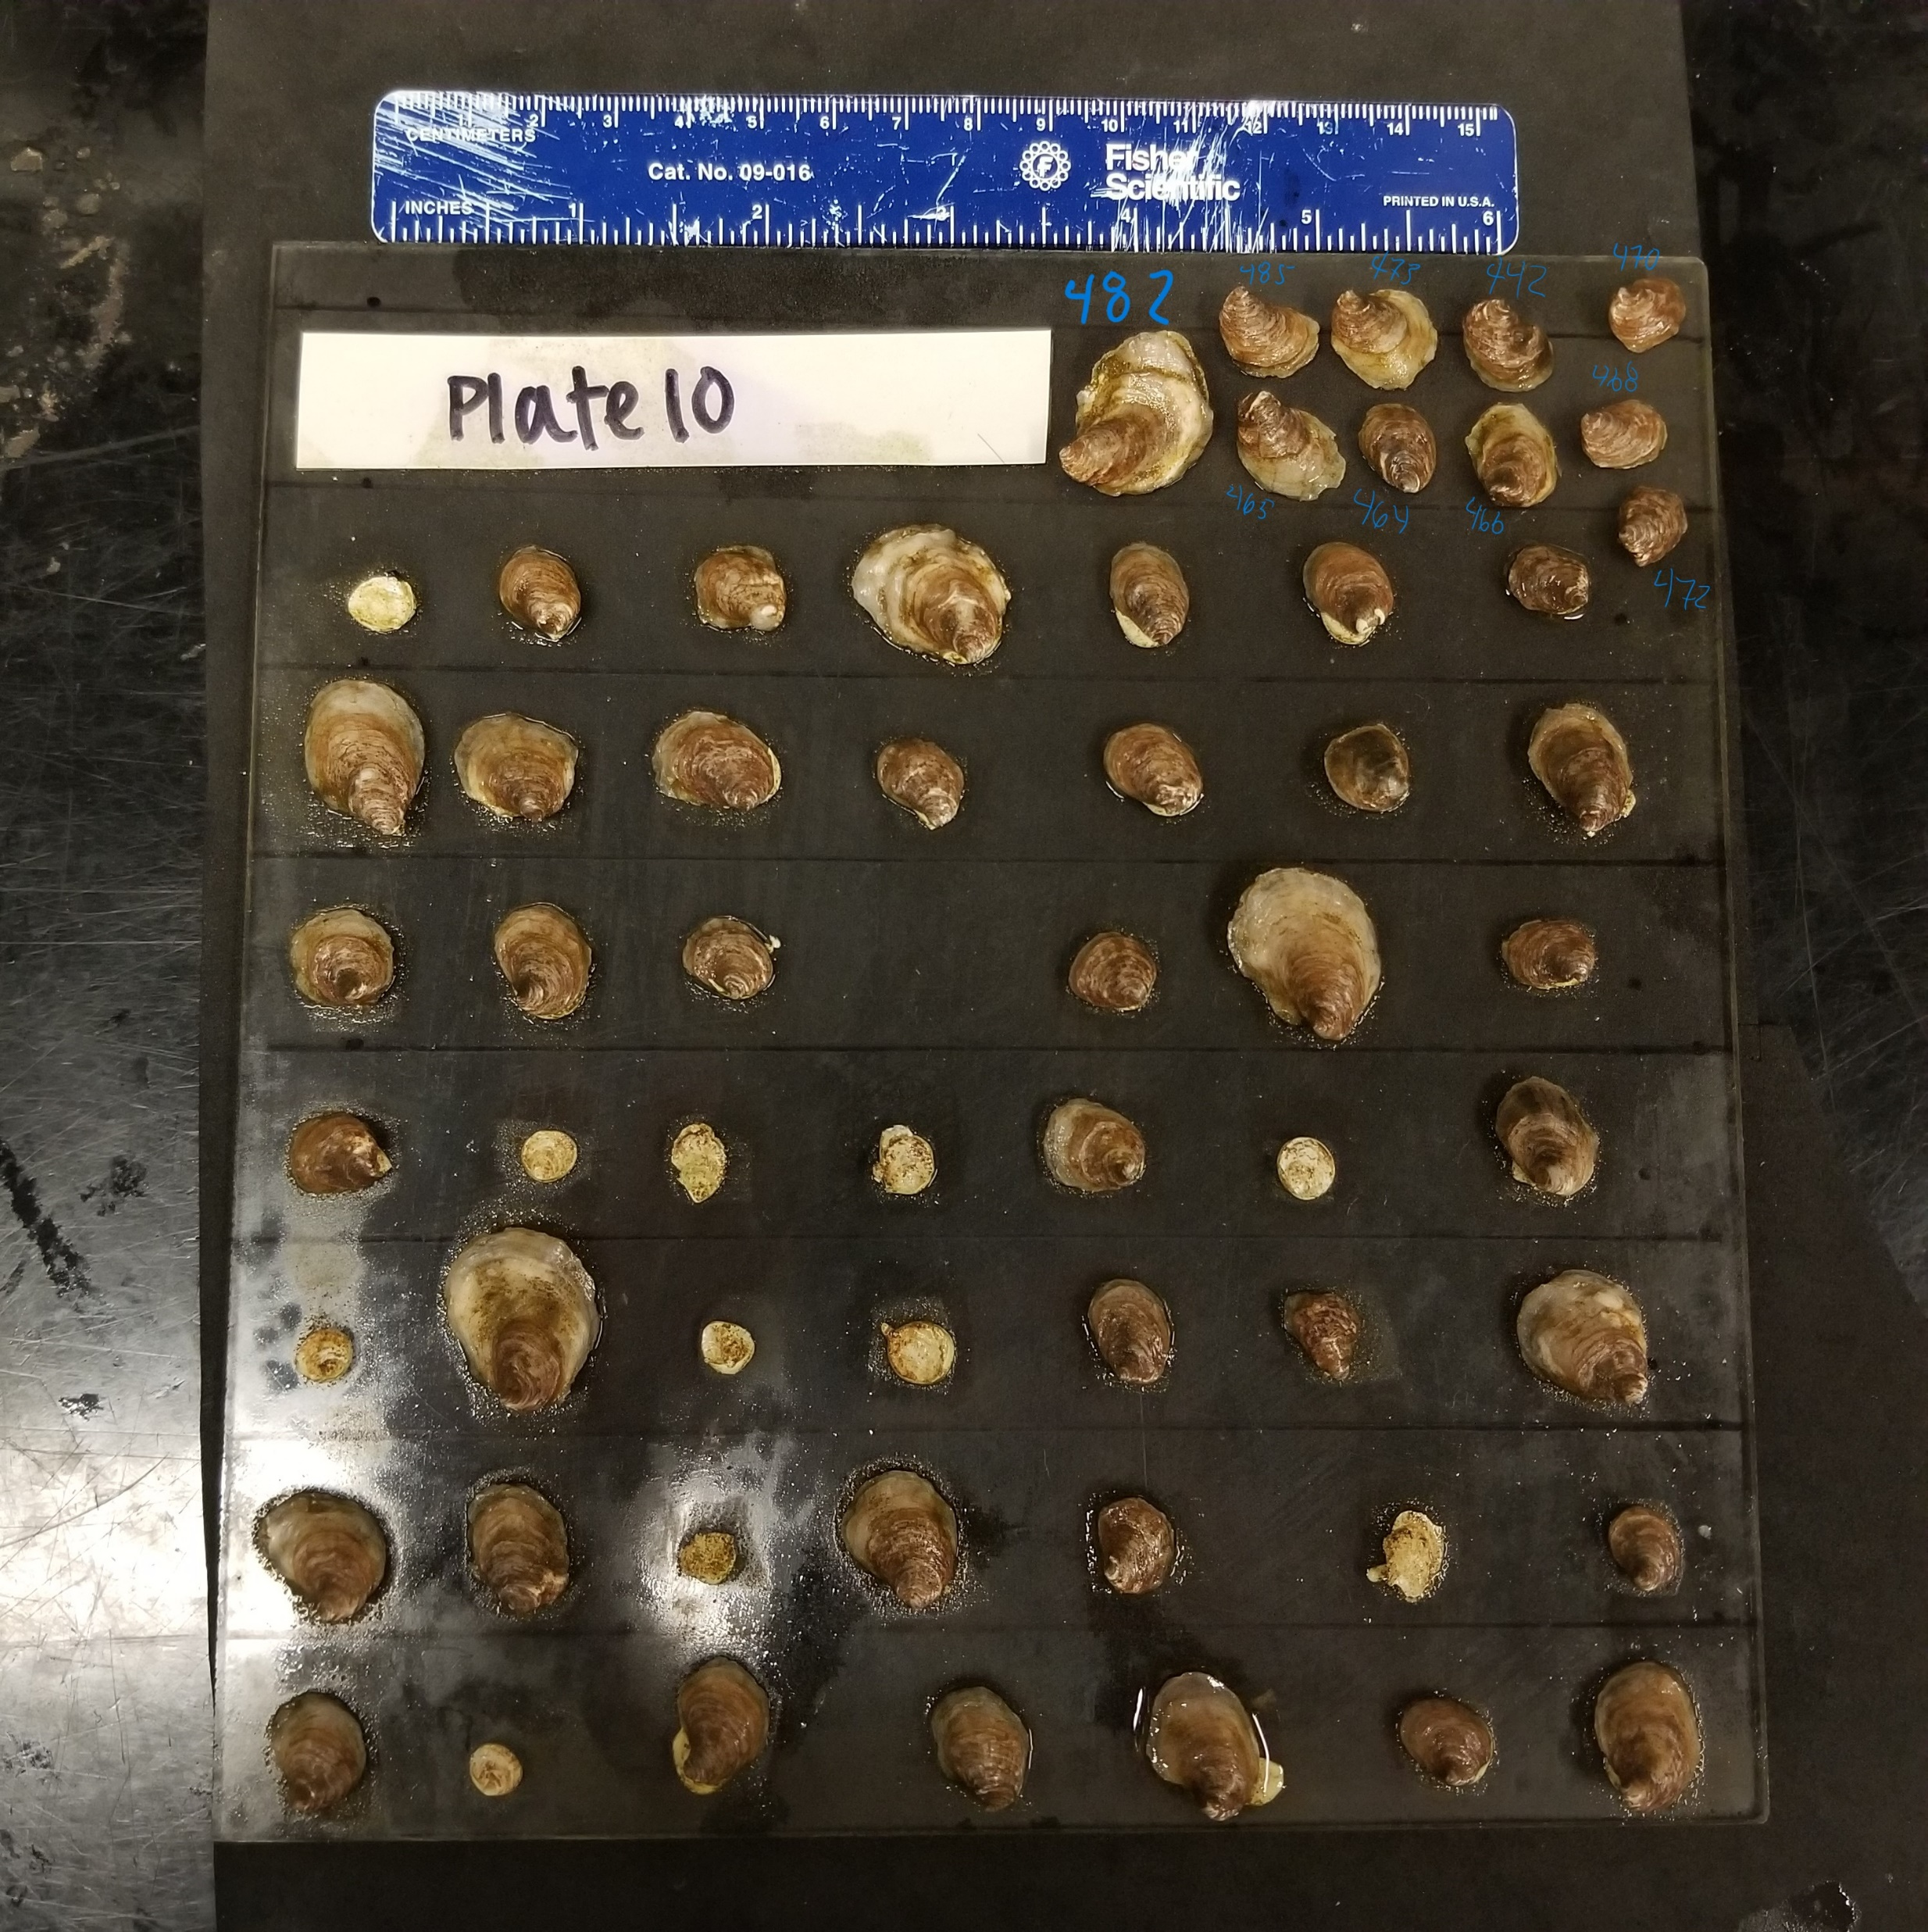
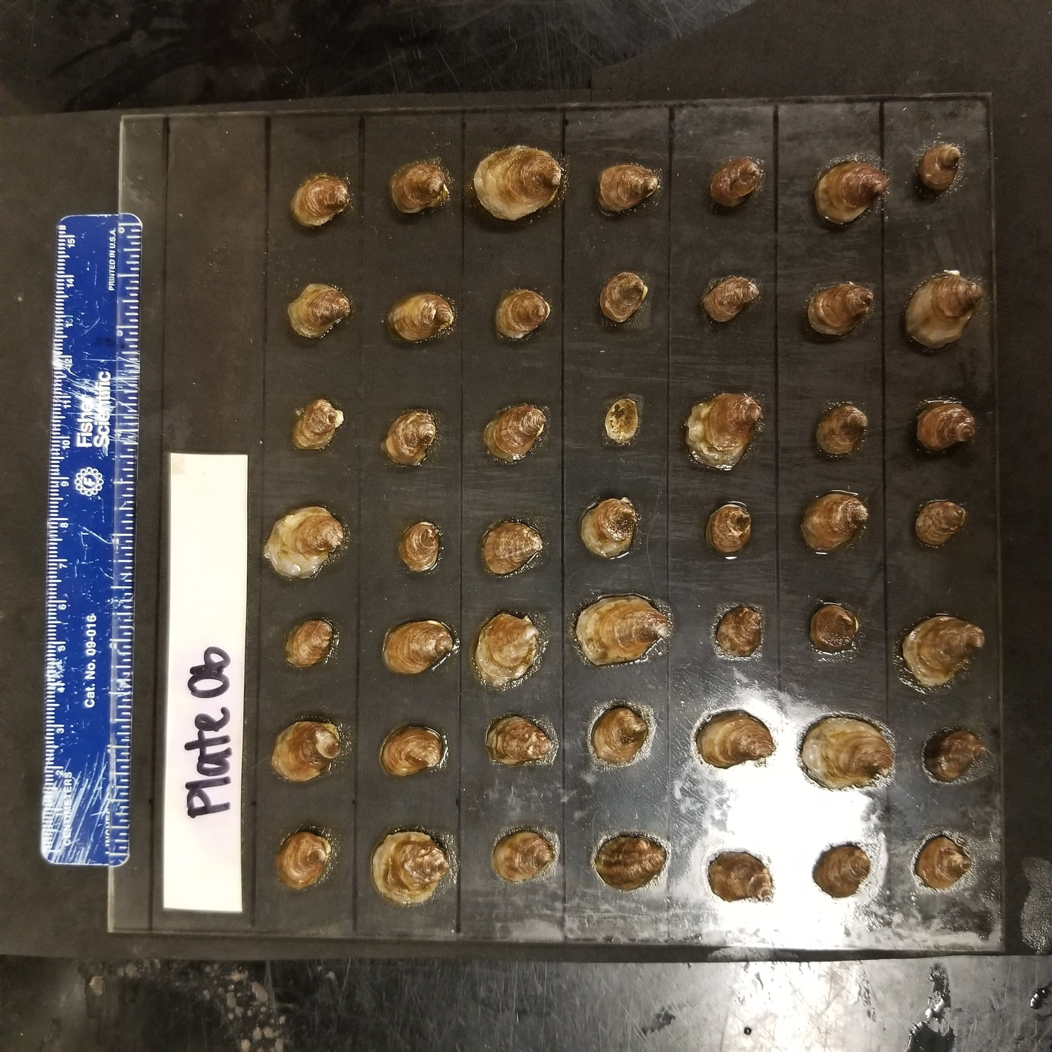
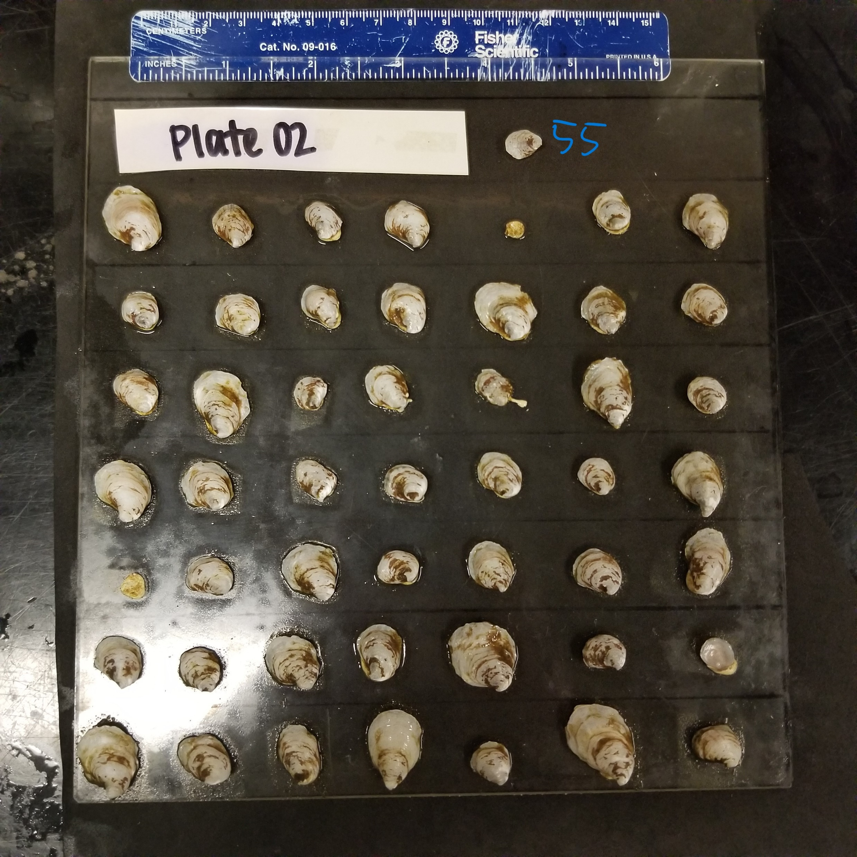
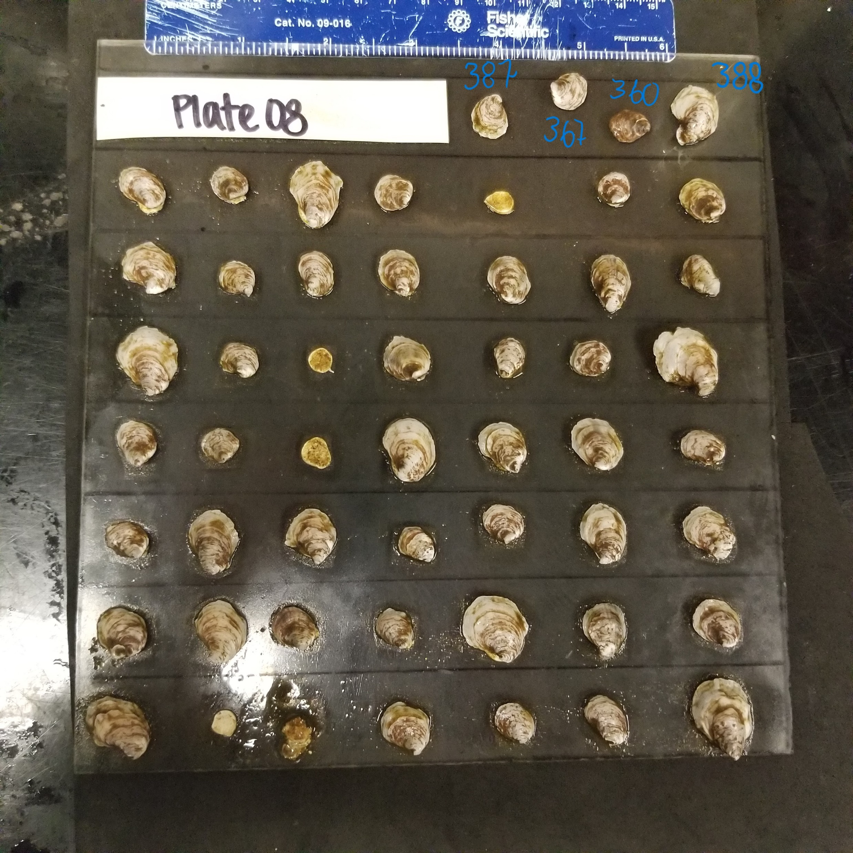
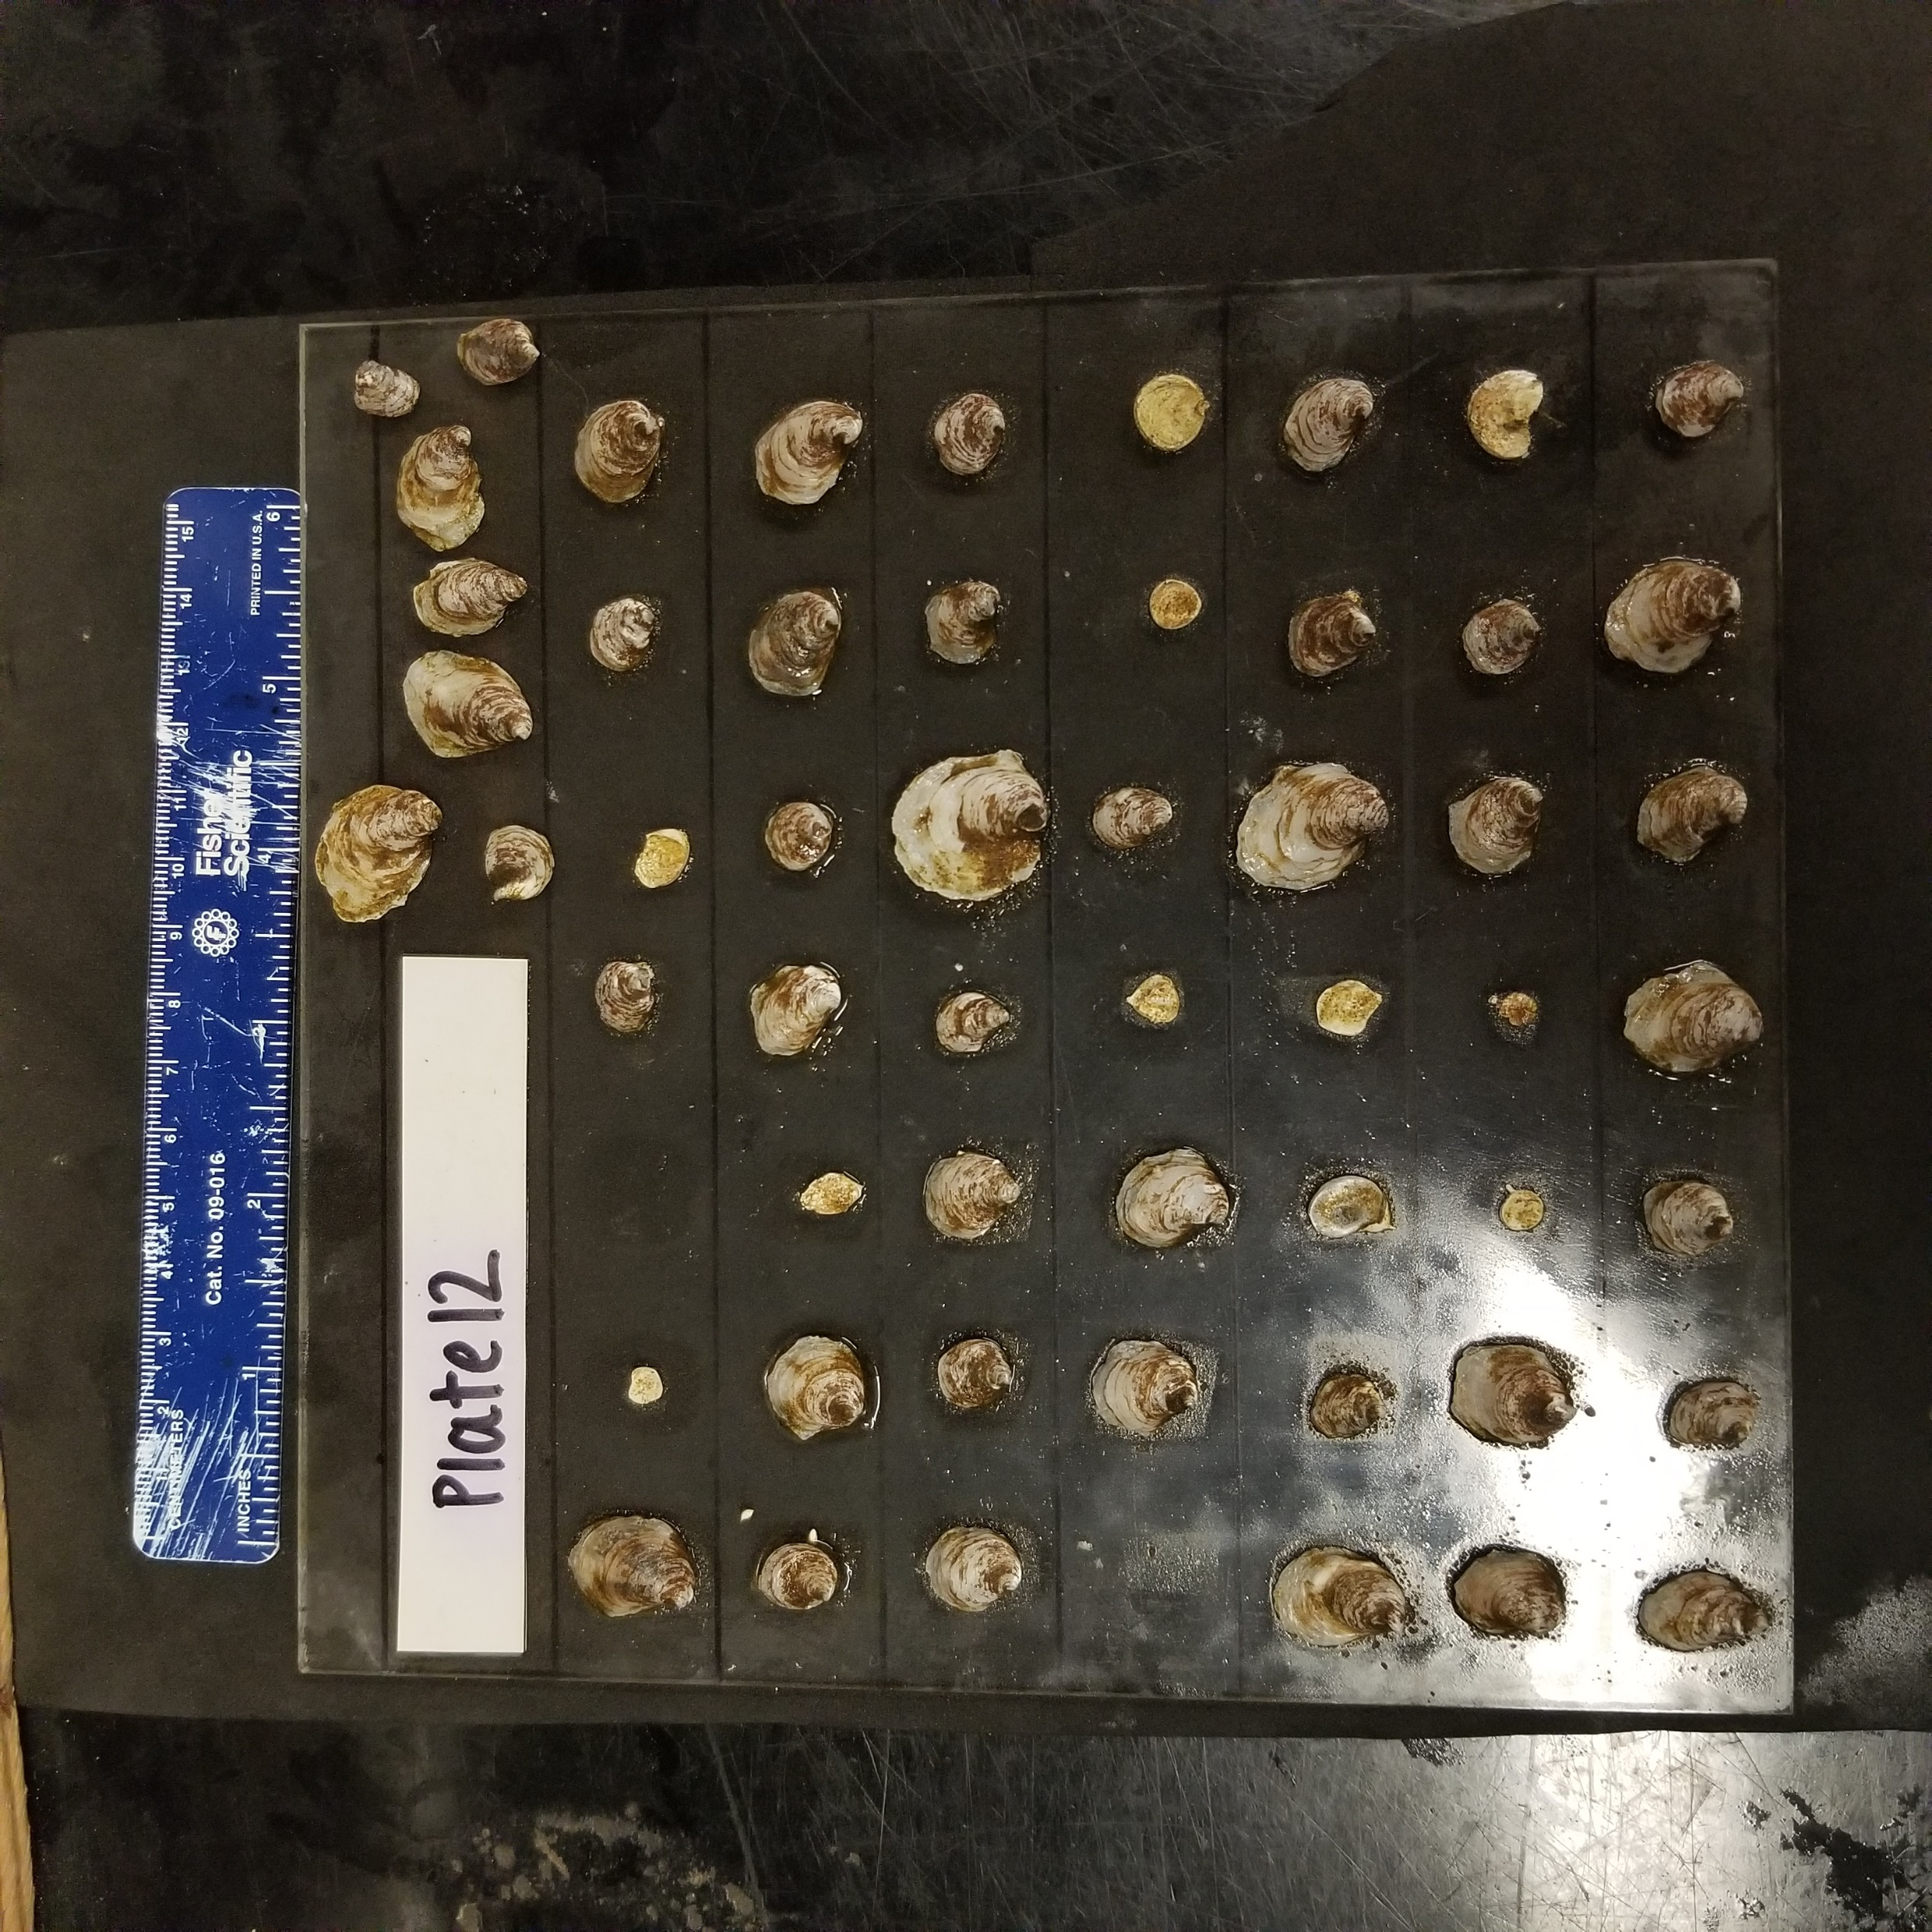
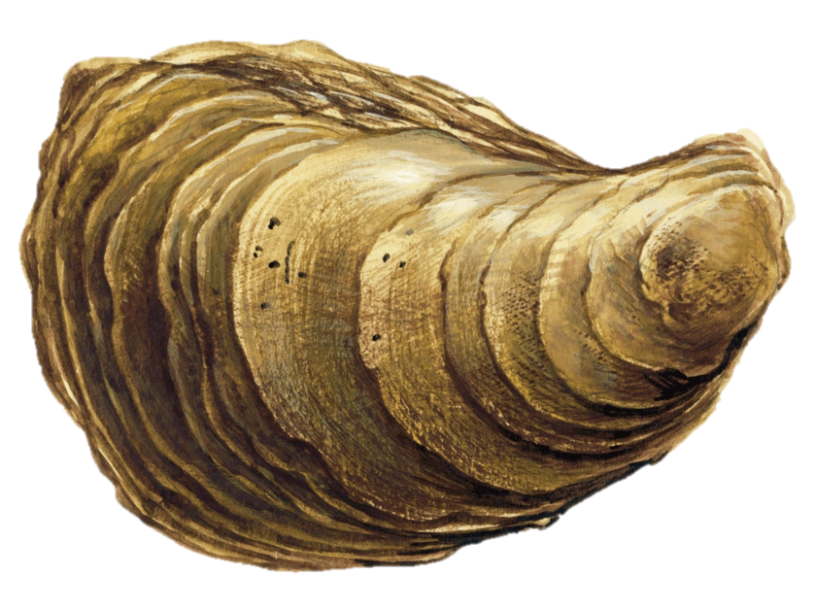
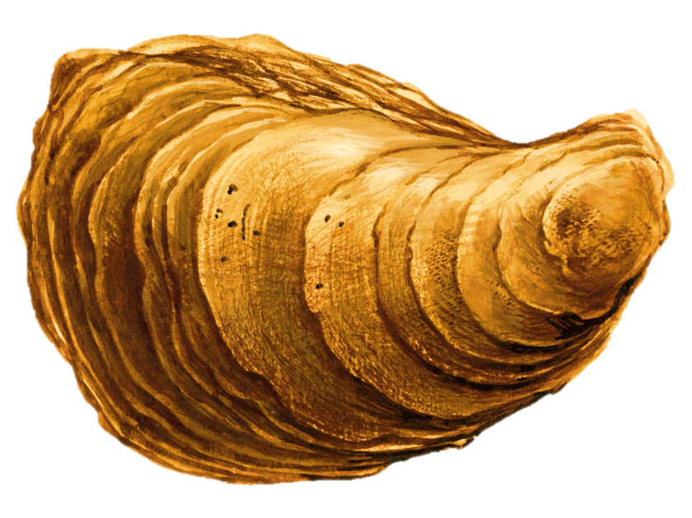
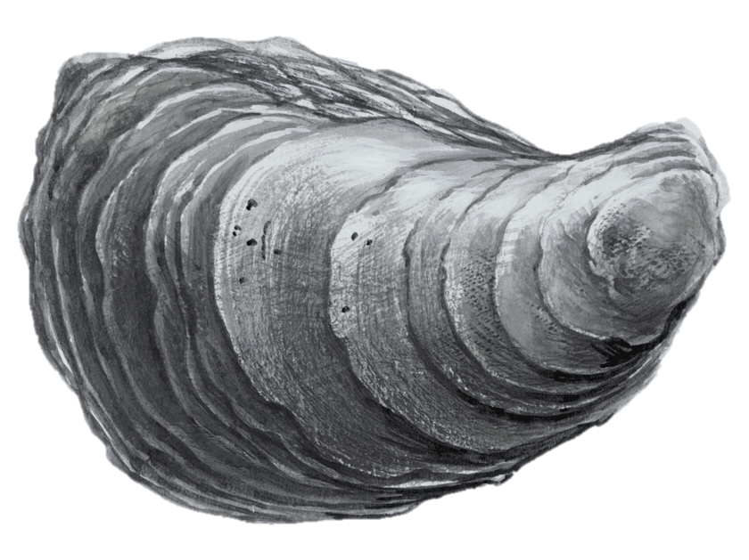
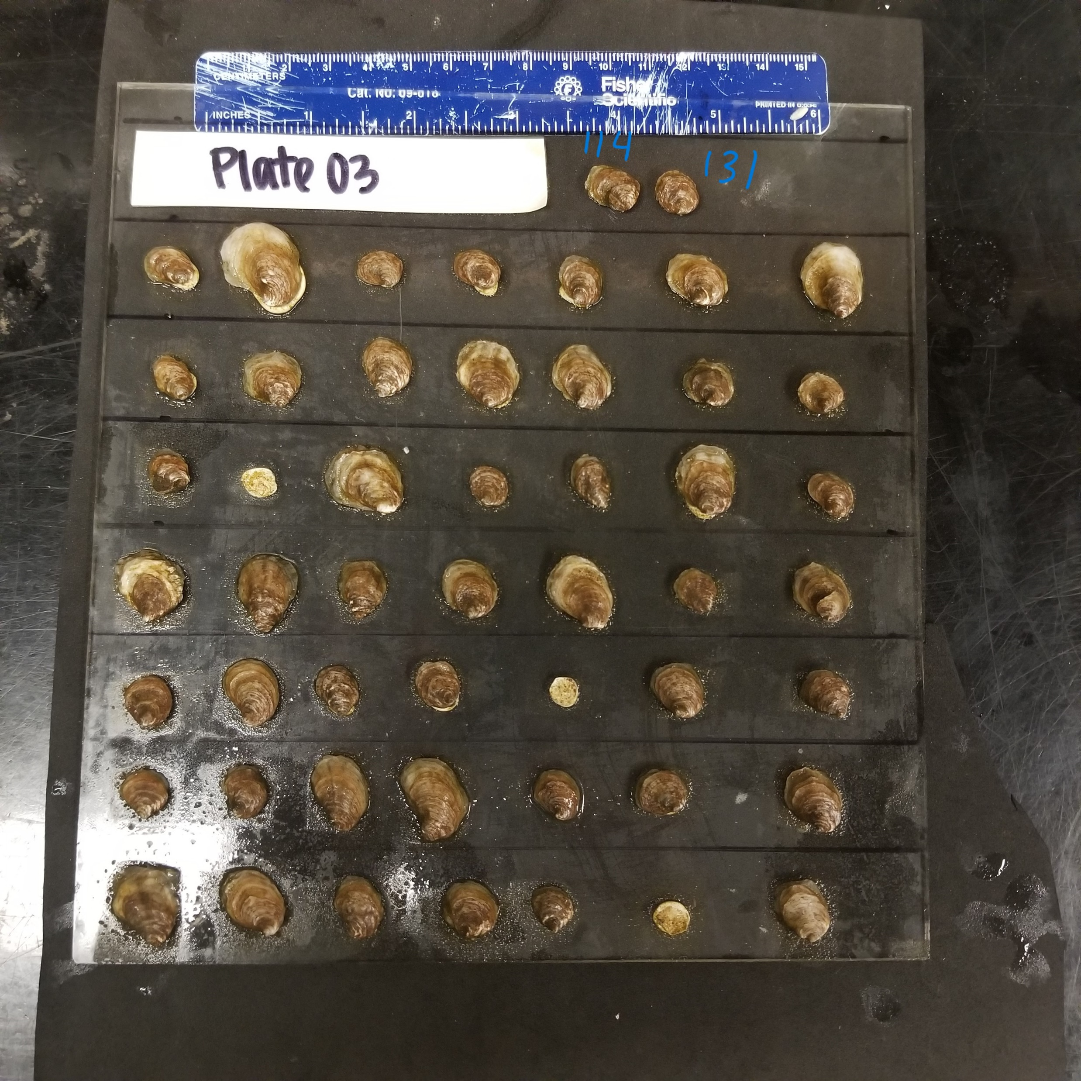
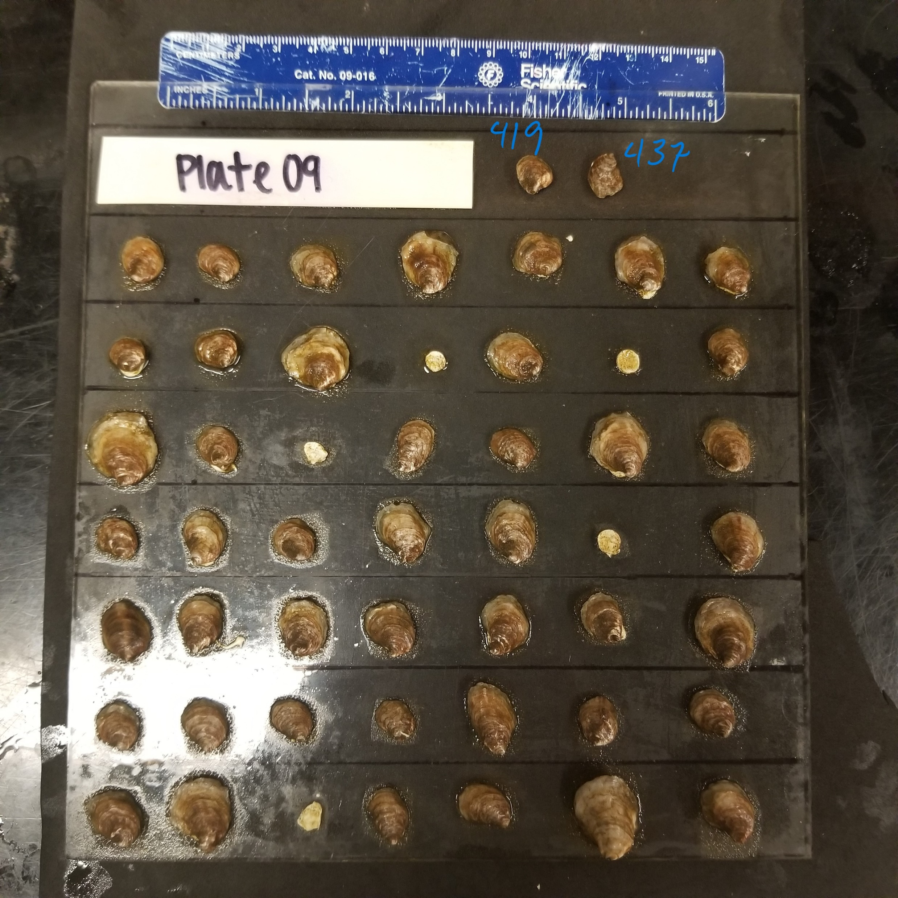

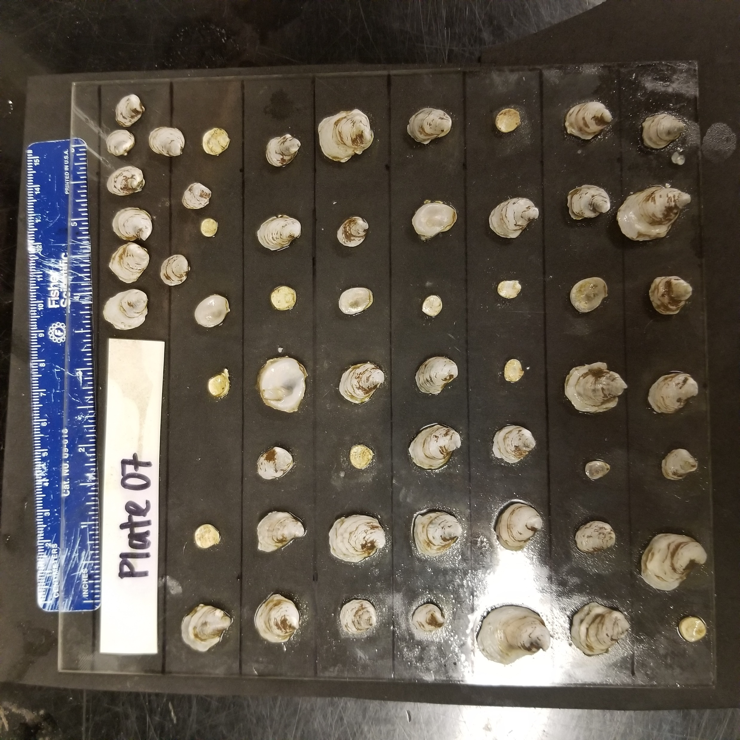
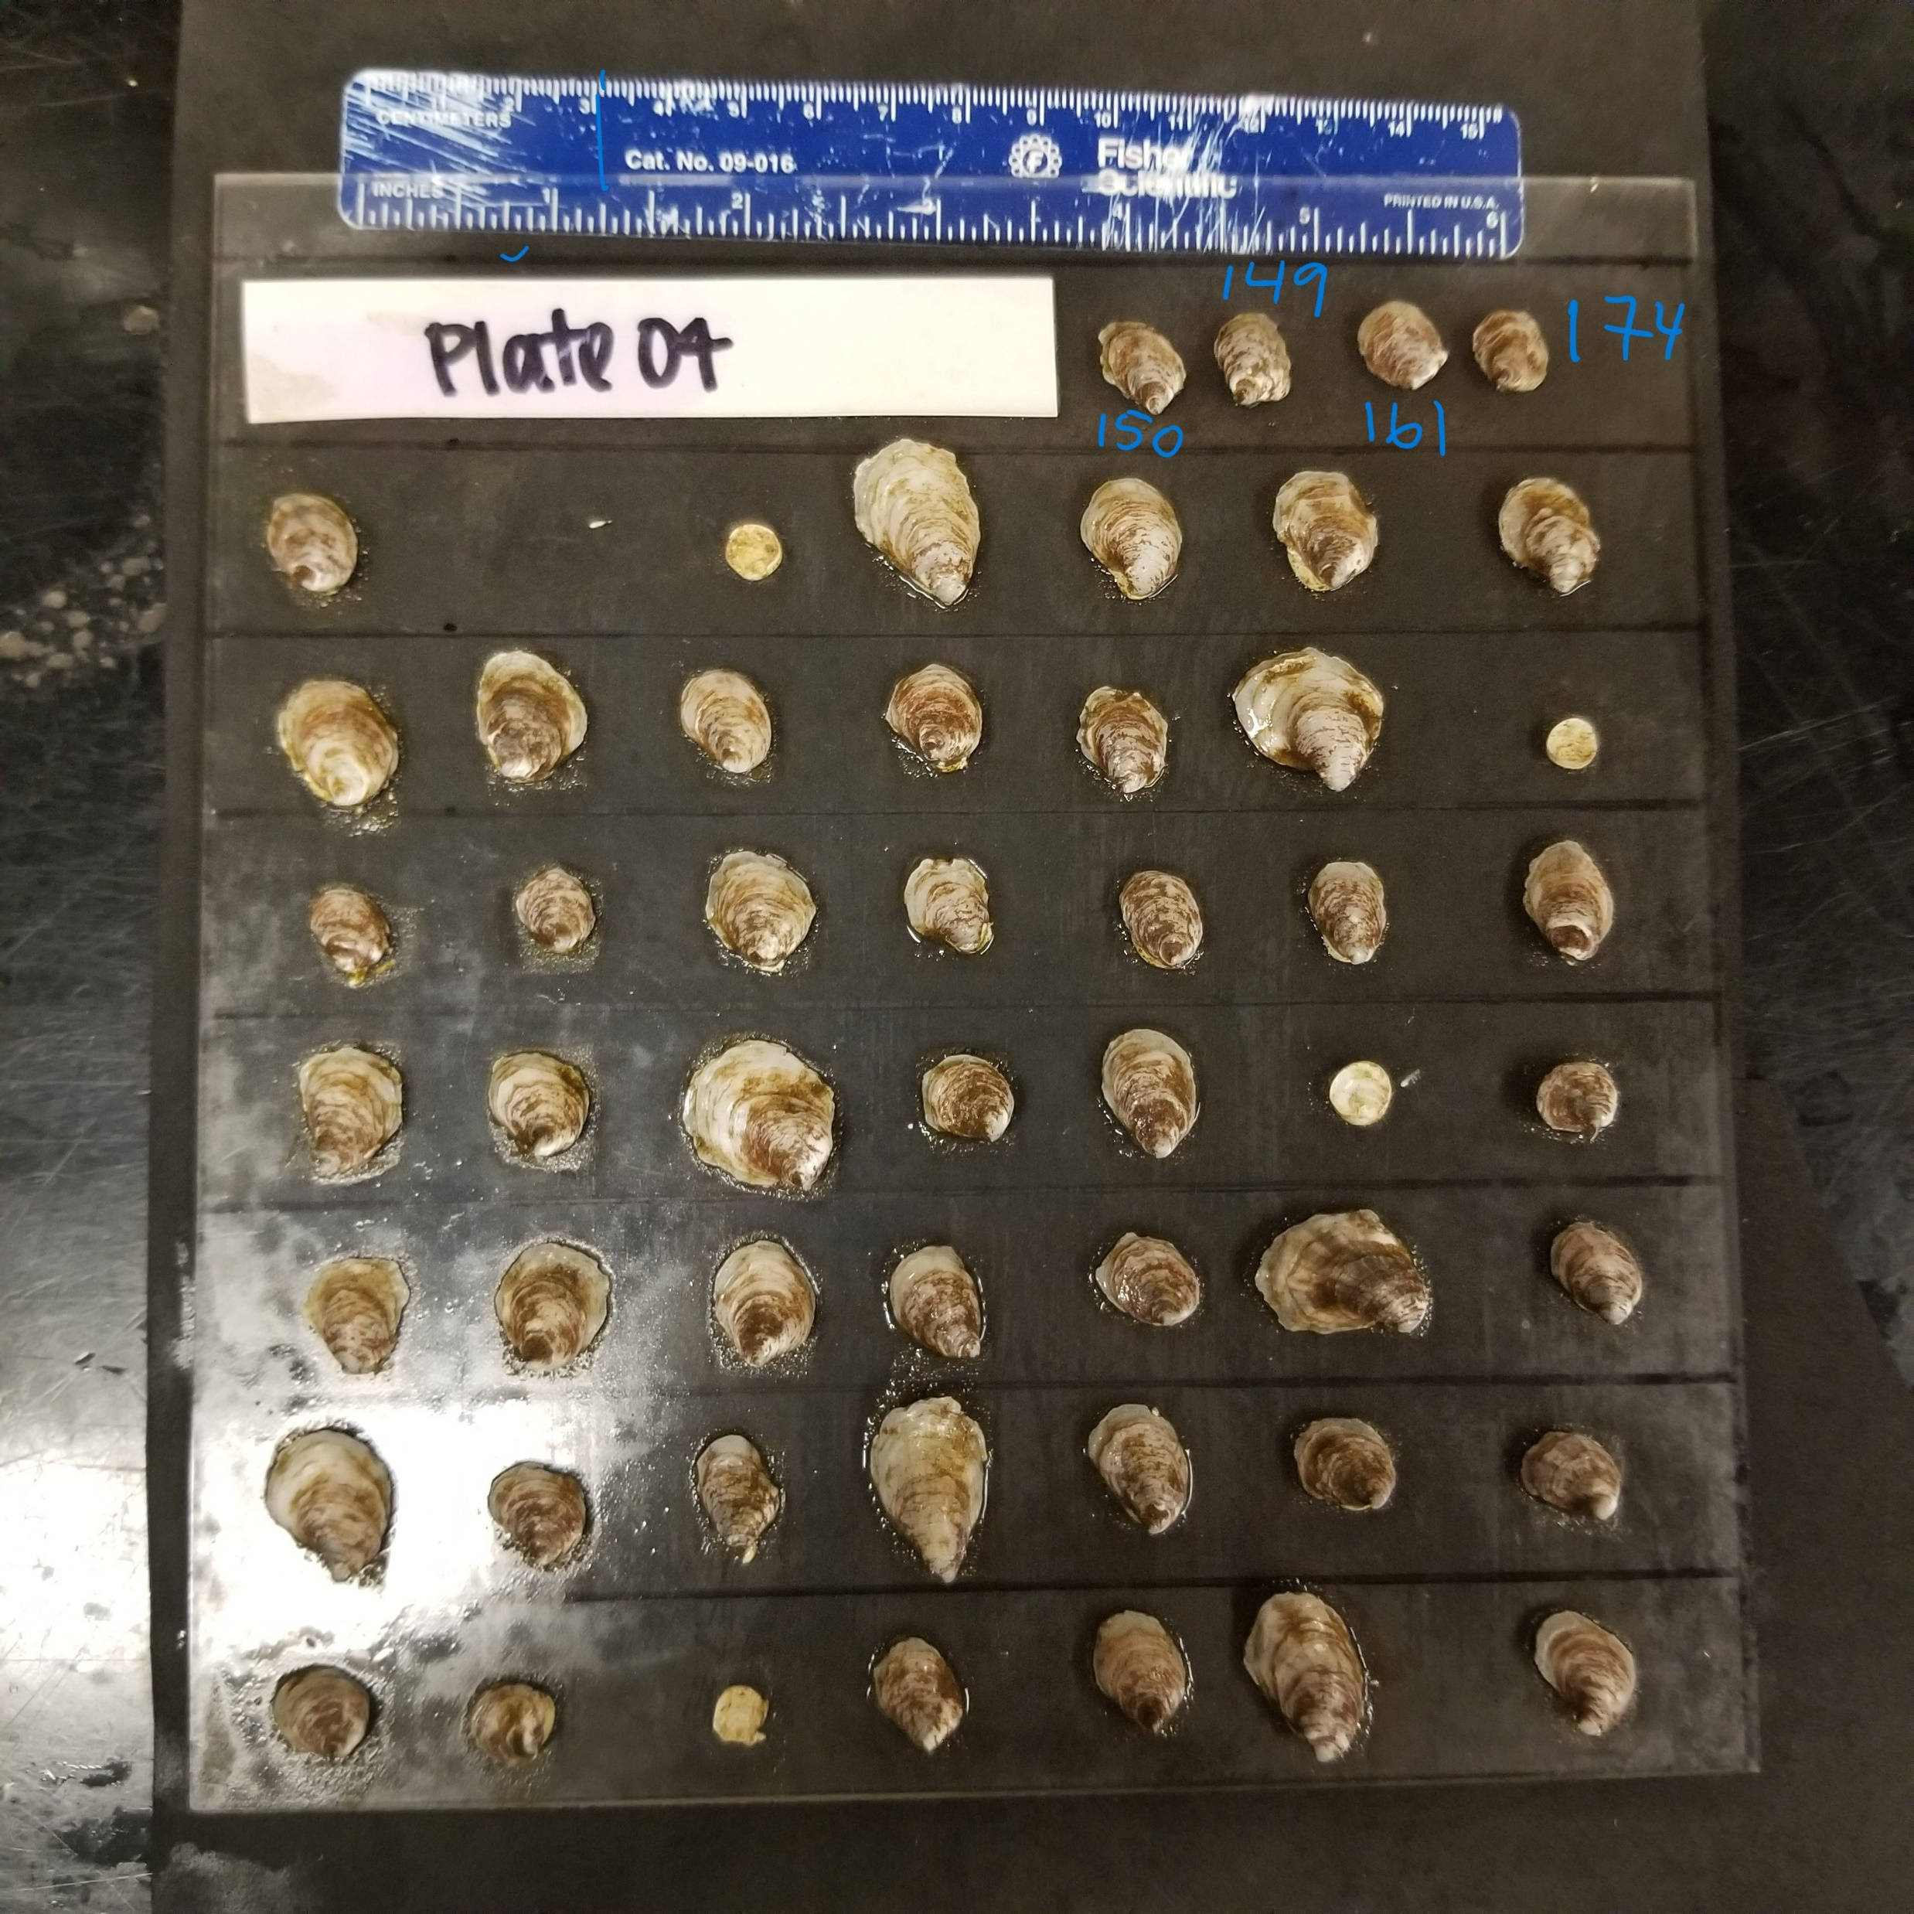
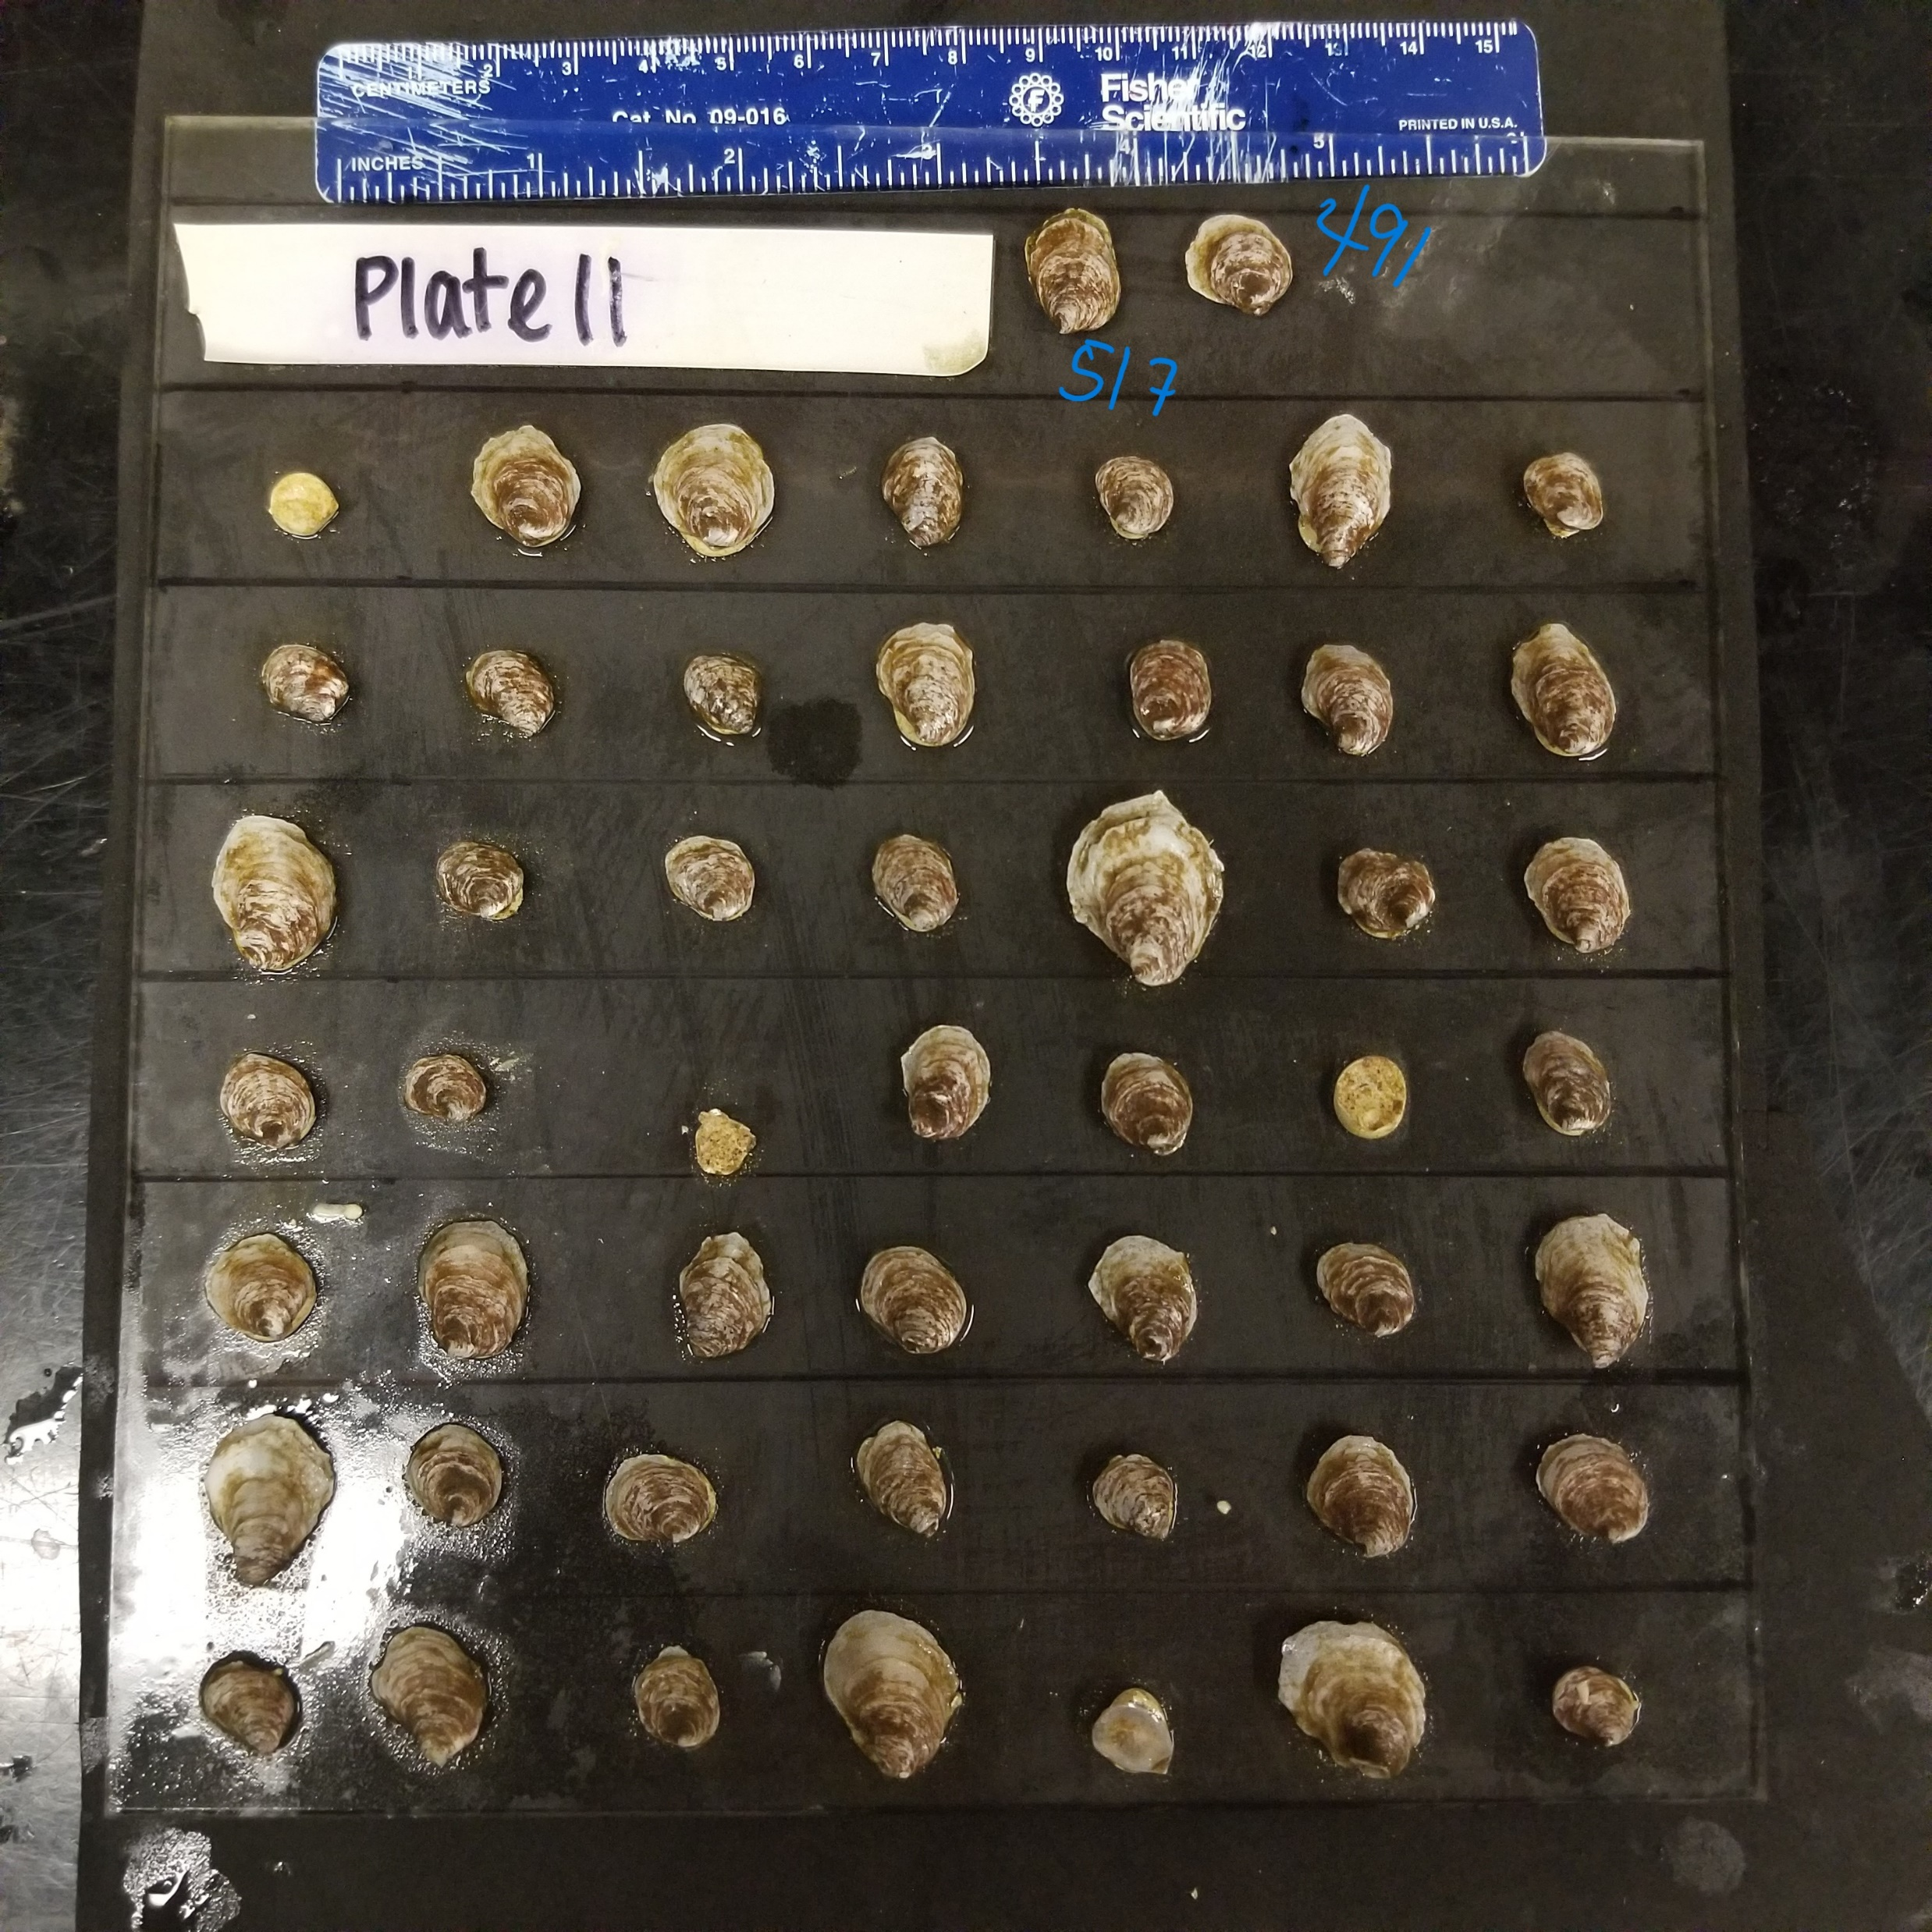
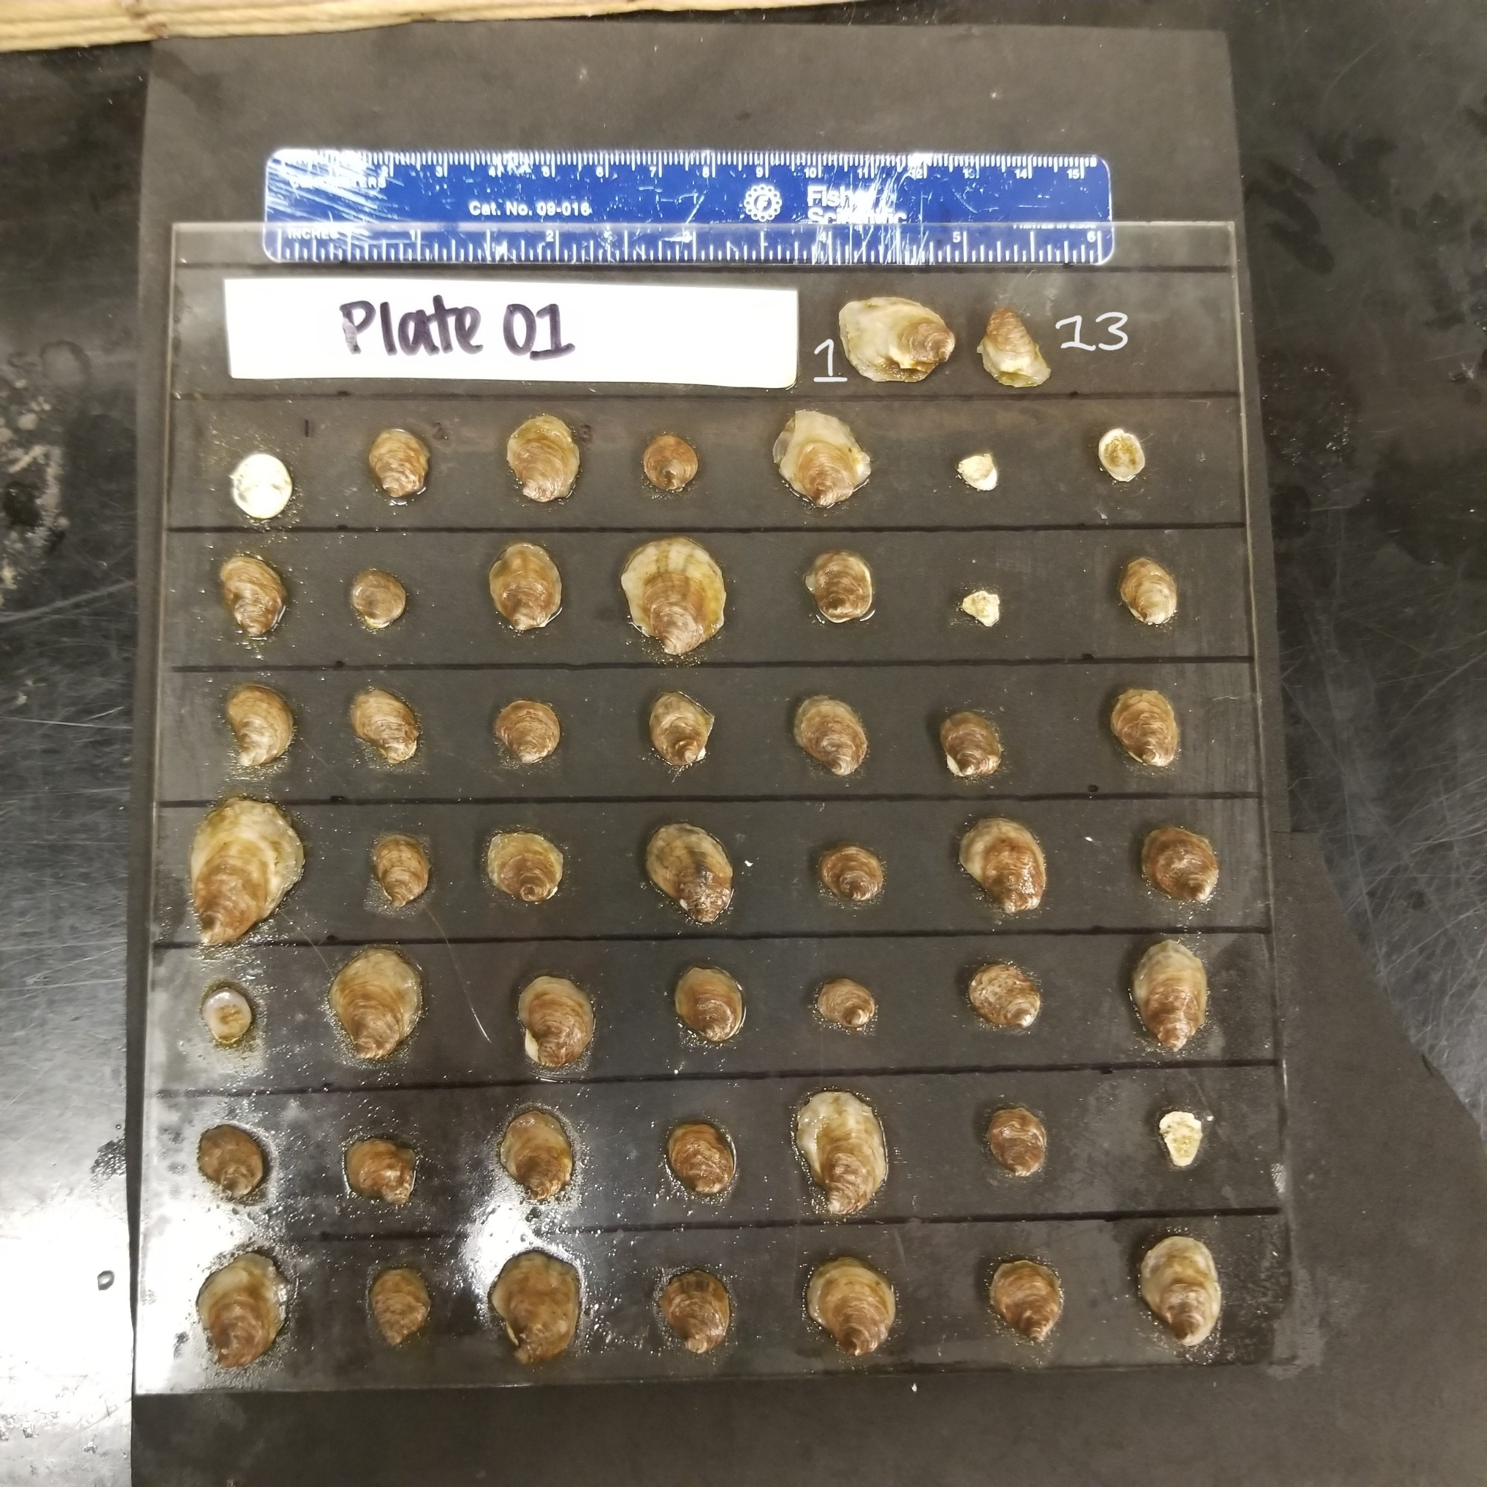
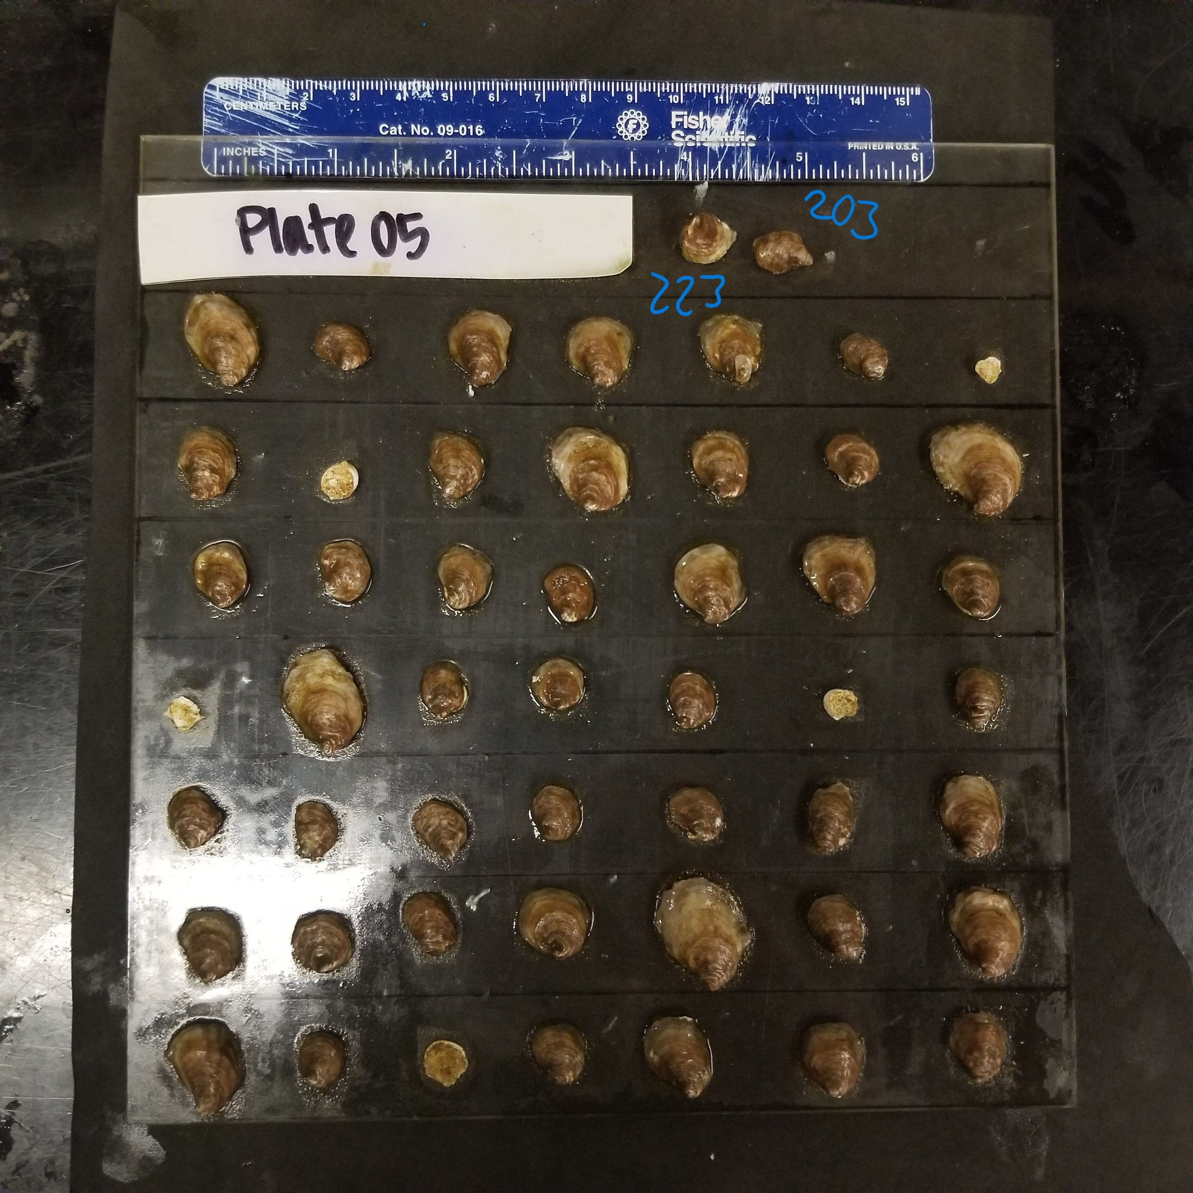
Arrange tiles from white → brown

Slide 20
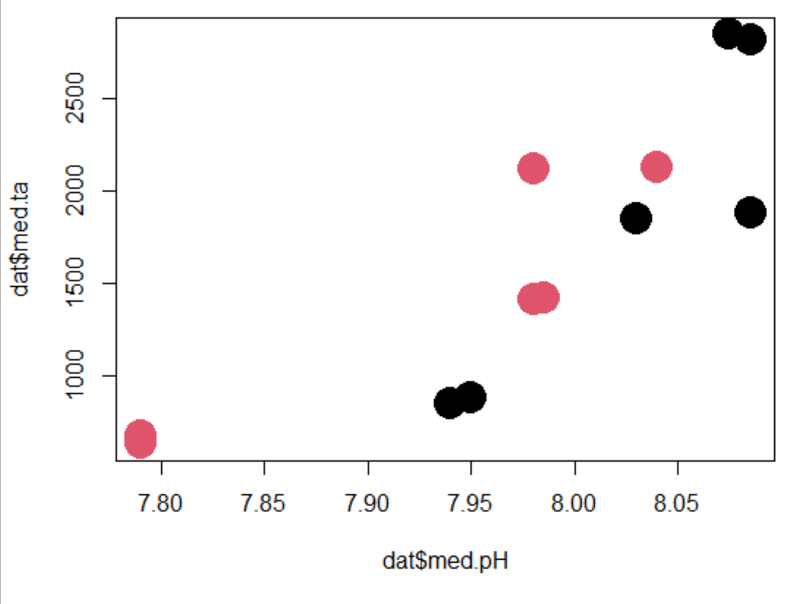
Color change is related to pH and TA, but not S
6
5
10
9
3
1
Median Total Alkalinity
4
8
12
11
2
7
Low ----------------------------------------> High
relative pH (across a 0.25 unit change)
Notes:
Bottom left: 2 and 7
Bottom middle: 11 (right) and 12 (left)
Middle middle: 4 (left) and 8 (same pH as 10; right)
Middle right: 1 (left) and 3 (right)
Middle top: 9 (right) and 10 (left; same pH as 4 and 8)
Top right: 5 (right) and 6 (left)

Slide 21
Color change is related to pH and TA, but not S
increasing pH improves coloration
increasing TA improves coloration
Median Total Alkalinity
Low ----------------------------------------> High
relative pH (across a 0.25 unit change)

Slide 22
Color change is related to pH and TA, but not S
increasing pH improves coloration
increasing TA improves coloration
Median Total Alkalinity
Low ----------------------------------------> High
relative pH (across a 0.25 unit change)

Slide 23
Color change is related to pH and TA, but not S
increasing pH improves coloration
increasing TA improves coloration
Median Total Alkalinity
Low ----------------------------------------> High
relative pH (across a 0.25 unit change)

Slide 24
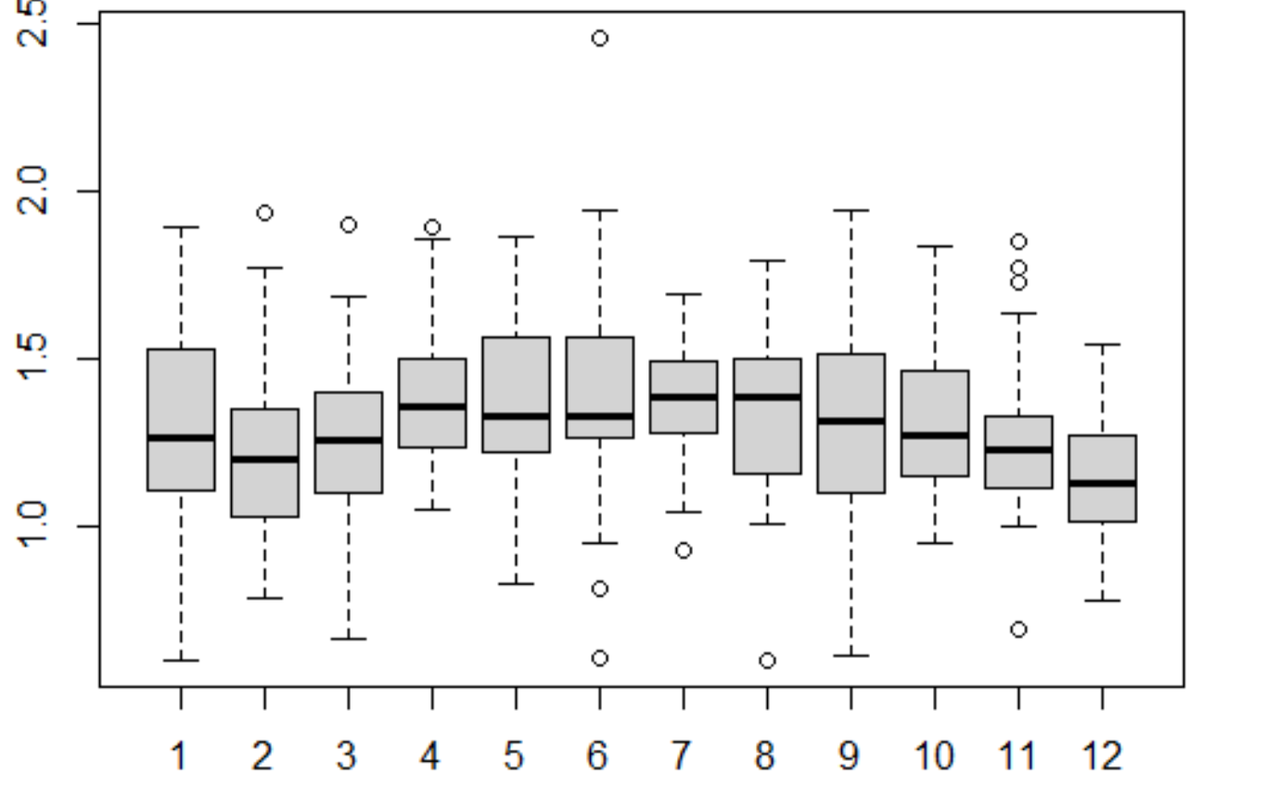
Do we see patterns related to organic content?
ab
d
d
ab
d
ab
1 2 3 4 5 6 7 8 9 10 11 12 "ab" "c" "b" "d" "d" "d" "d" "ad" "ab" "ab" "bc" "e"
c
ad
b
d
bc
e

Slide 25
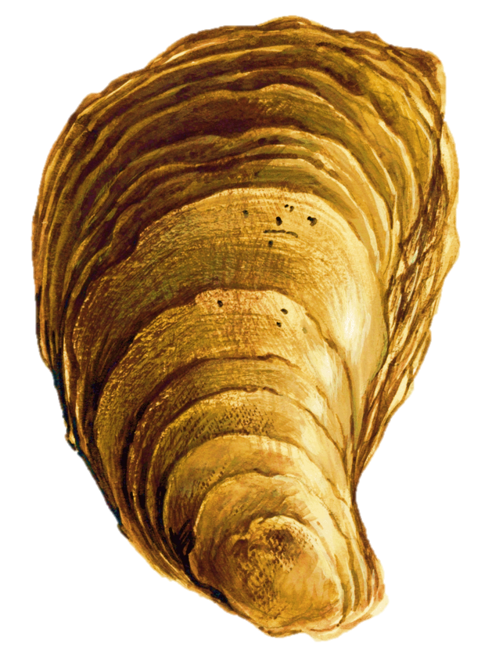
Assigning each group a ‘saturation’ icon
d
ad
e
ab
c
ab
ab
d
d
bc
b
d

Slide 26
Color change is related to pH and TA, but not S
d
d
ab
ab
b
ab
Median Total Alkalinity
ad
d
d
c
bc
e
Low ----------------------------------------> High
relative pH (across a 0.25 unit change)

Slide 27
Color change is related to pH and TA, but not S
d
d
ab
No apparent trend in similarity between the color change and the % organic material
Only comprising between 1-2% of the shell and so may be difficult to see differences in such small changes (based on just perio being removed)
ab
b
Higher % OC
ab
Median Total Alkalinity
ad
d
d
c
bc
e
Low ----------------------------------------> High
relative pH (across a 0.25 unit change)

Slide 28
Color change is related to pH and TA, but not S
d
d
ab
No apparent trend in similarity between the color change and the % organic material
Only comprising between 1-2% of the shell and so may be difficult to see differences in such small changes (based on just perio being removed)
Middle % OC
ab
b
ab
Median Total Alkalinity
ad
d
d
c
bc
e
Low ----------------------------------------> High
relative pH (across a 0.25 unit change)

Slide 29
Color change is related to pH and TA, but not S
d
d
ab
No apparent trend in similarity between the color change and the % organic material
Only comprising between 1-2% of the shell and so may be difficult to see differences in such small changes (based on just perio being removed)
ab
b
ab
Median Total Alkalinity
Low % OC
ad
d
d
c
bc
e
Low ----------------------------------------> High
relative pH (across a 0.25 unit change)

Slide 30
Color change is related to pH and TA, but not S
d
d
ab
No apparent trend in similarity between the color change and the % organic material
Only comprising between 1-2% of the shell and so may be difficult to see differences in such small changes (based on just perio being removed)
Middle % OC
ab
b
Higher % OC
ab
Median Total Alkalinity
Low % OC
ad
d
d
c
bc
e
Low ----------------------------------------> High
relative pH (across a 0.25 unit change)

Slide 31
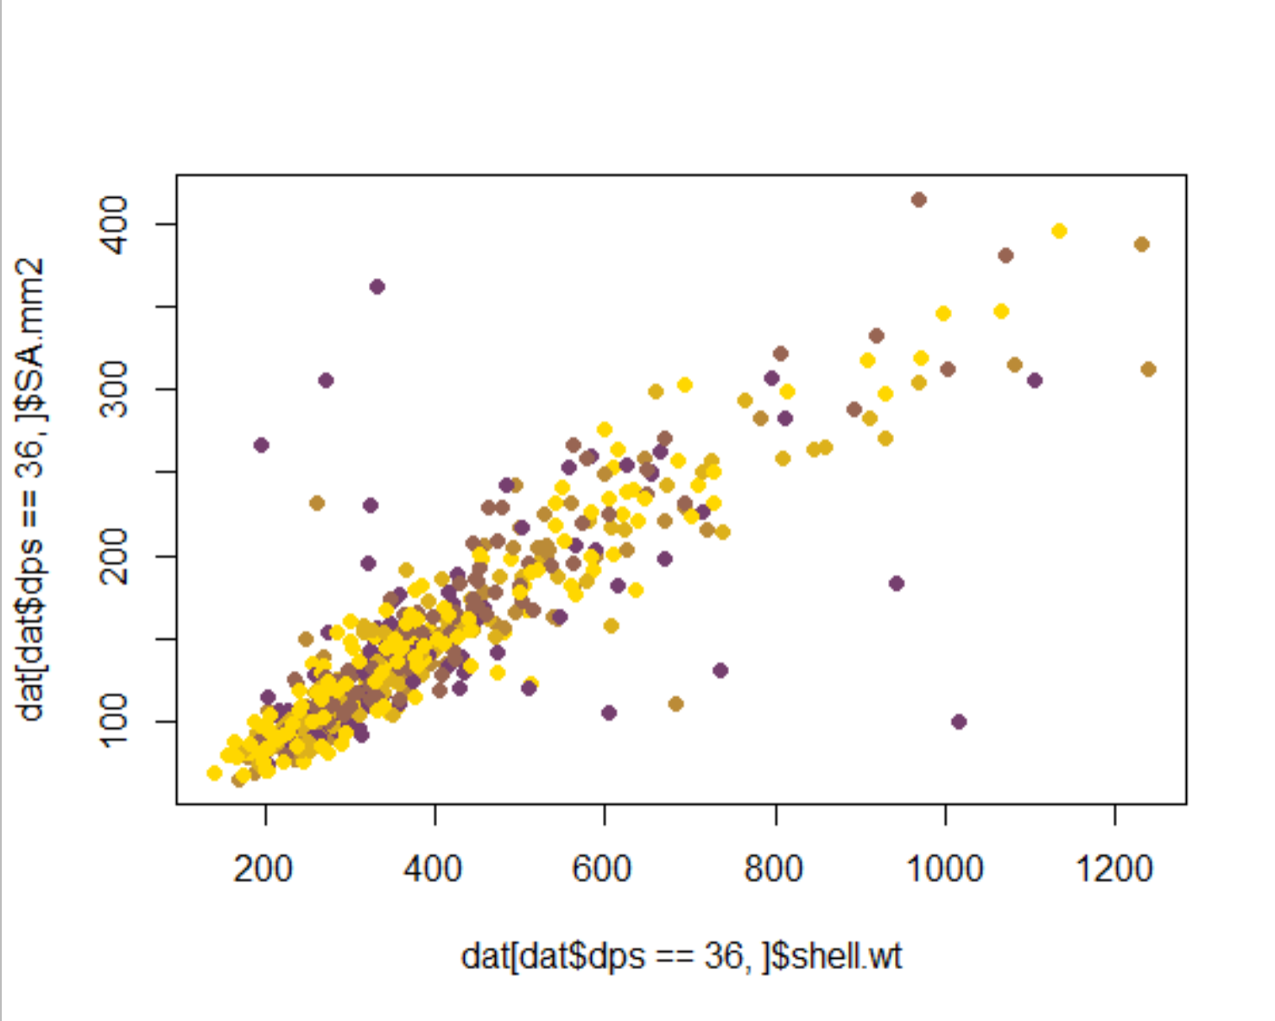
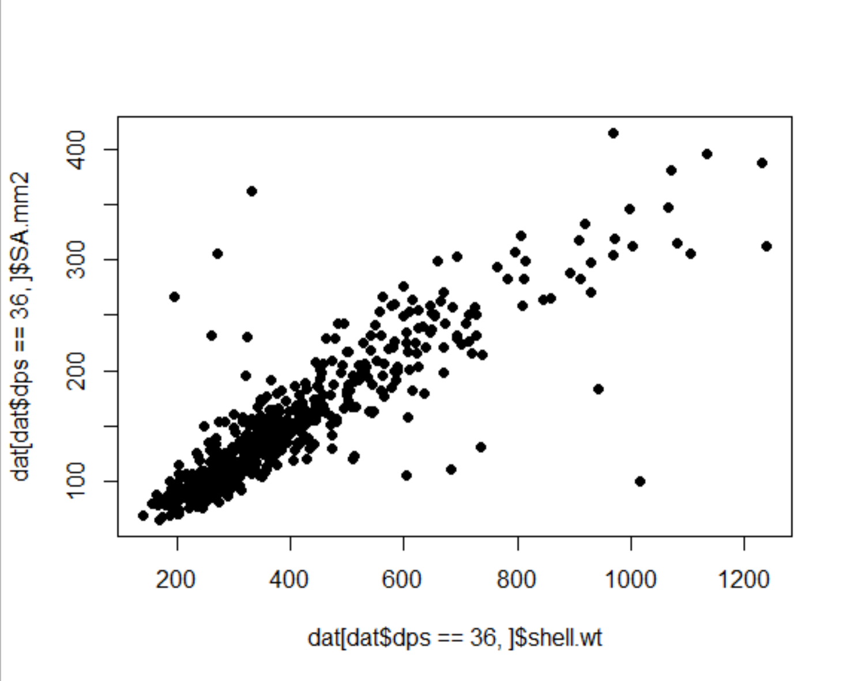
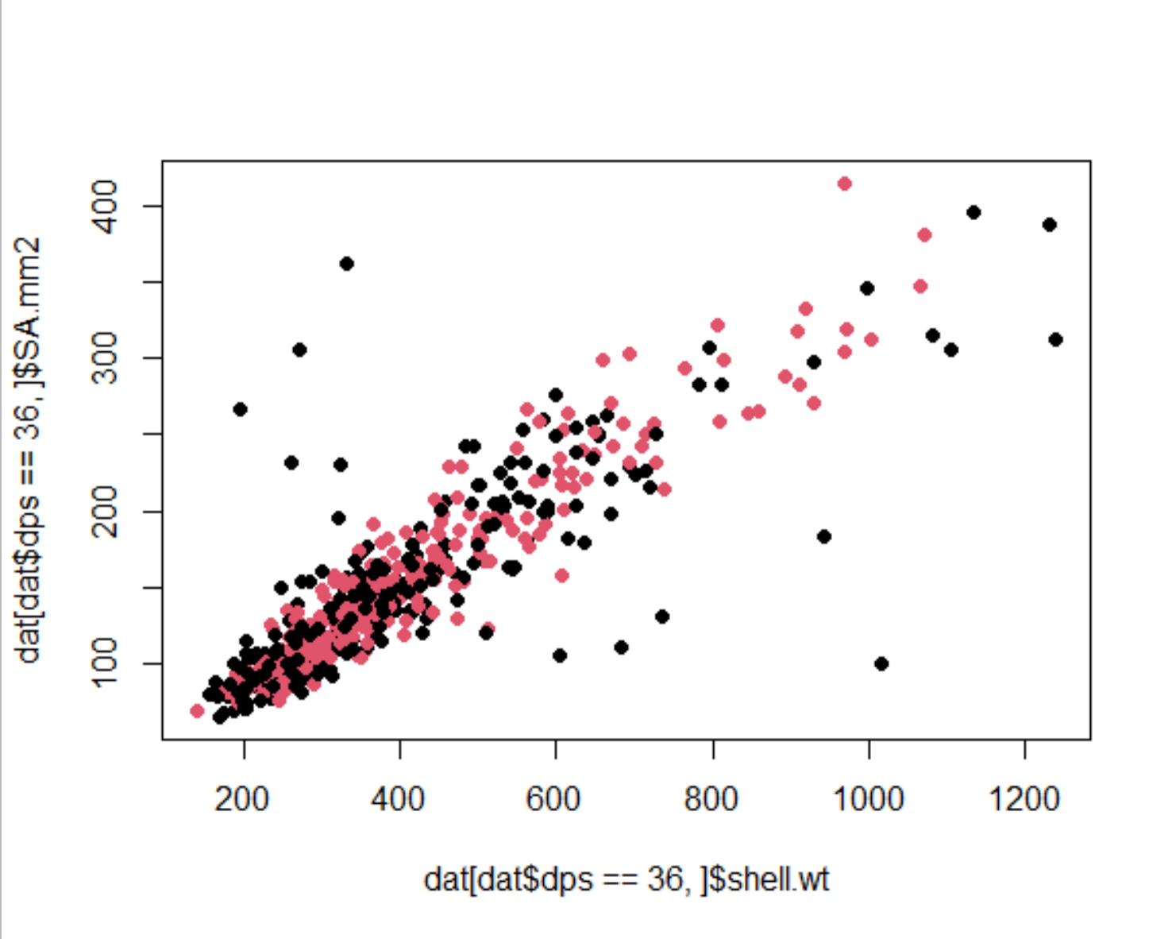
Shell wt. and SA have very tight relationship; no apparent grouping by TA or S… shell composition is similar

Slide 32
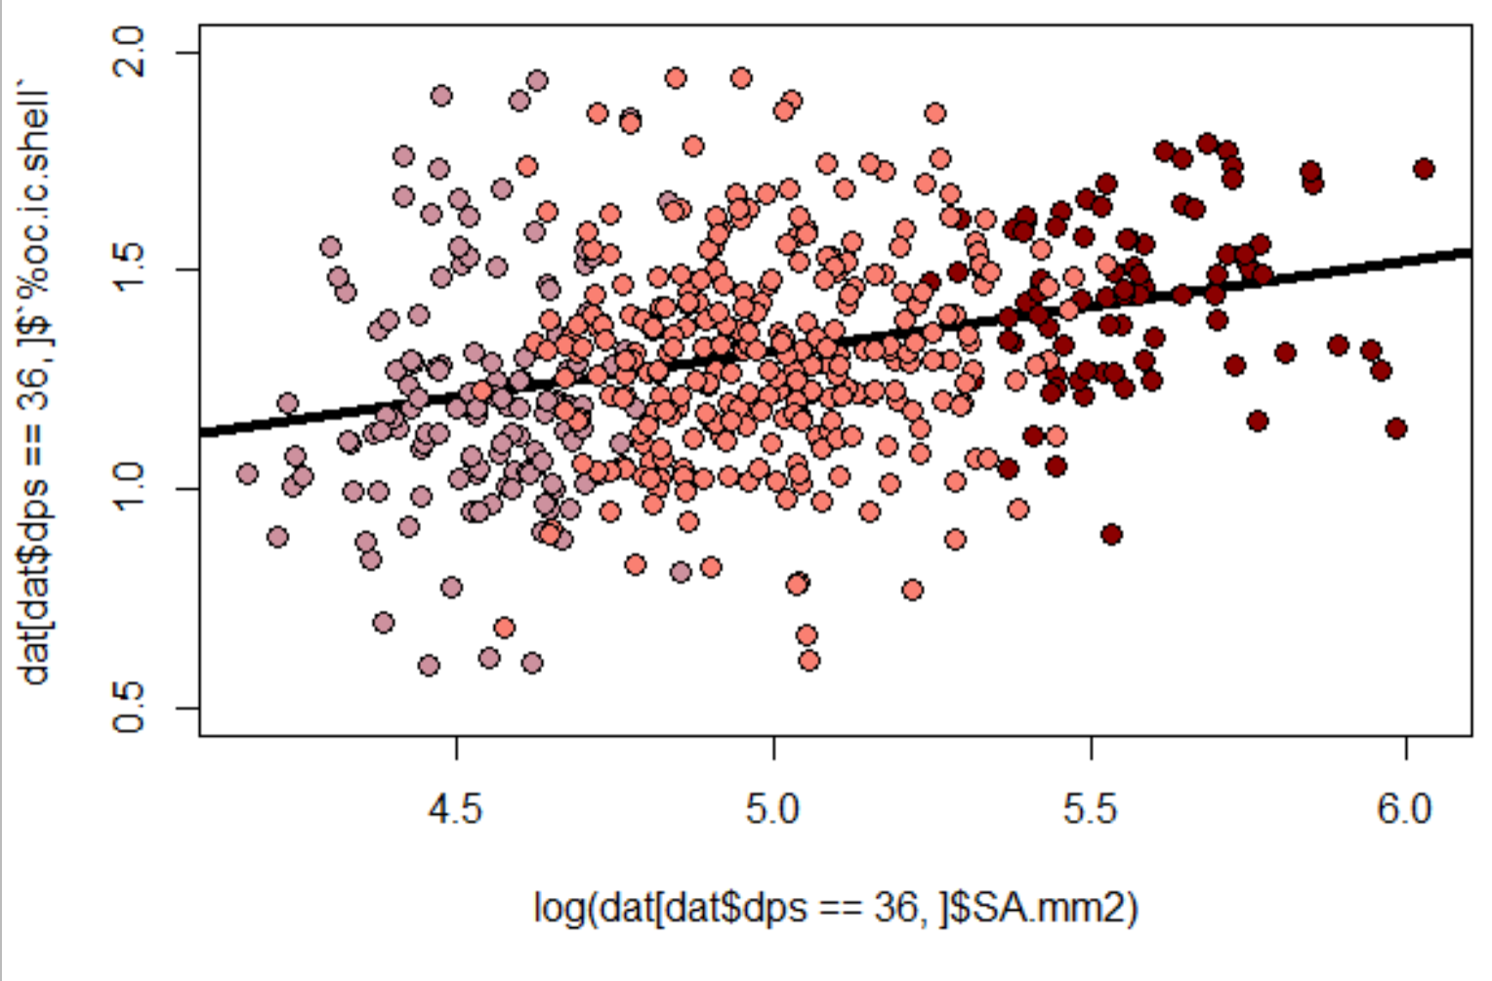
Relationship between size and organic content.. Did not change among different size classes
Larger SA had higher prop of shell as OC matter, makes sense with surface area drive growth
Also suggests that TA nor S strongly dictated the prevalence of a substantial organic layer on shells

Slide 33
Suggesting… the color of the shell, although driven by the presence of periostracum, must also gain color via bacteria/diatom growth
color loss implications for:
1. albedo effect/temperature in low tide?
2. biological layer (vs. organic) between seawater
i. change interaction with biochemical reactions in benthos

Slide 34
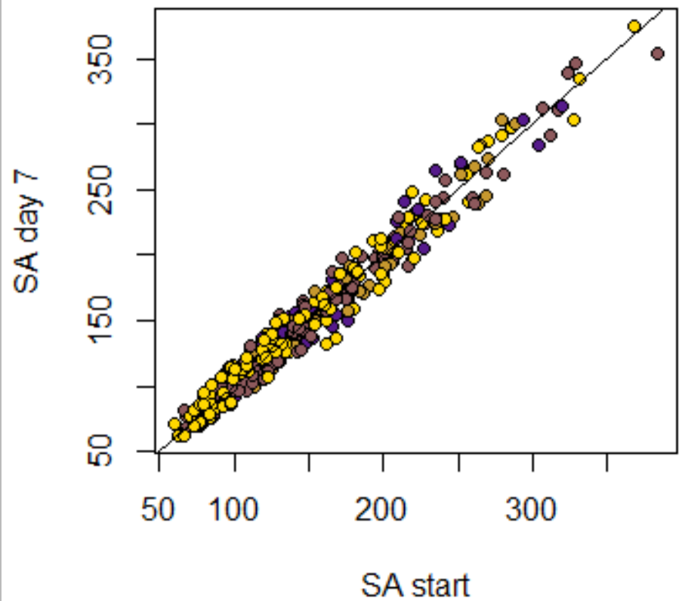
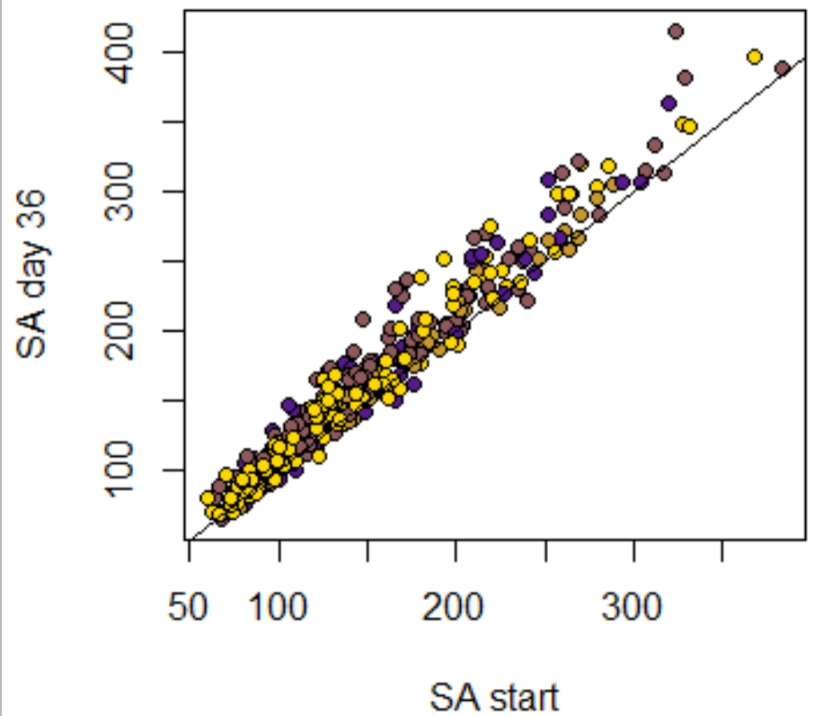
Increased TA results in higher SA growth; however, growth rates were higher in low S (not pictured)

Slide 35
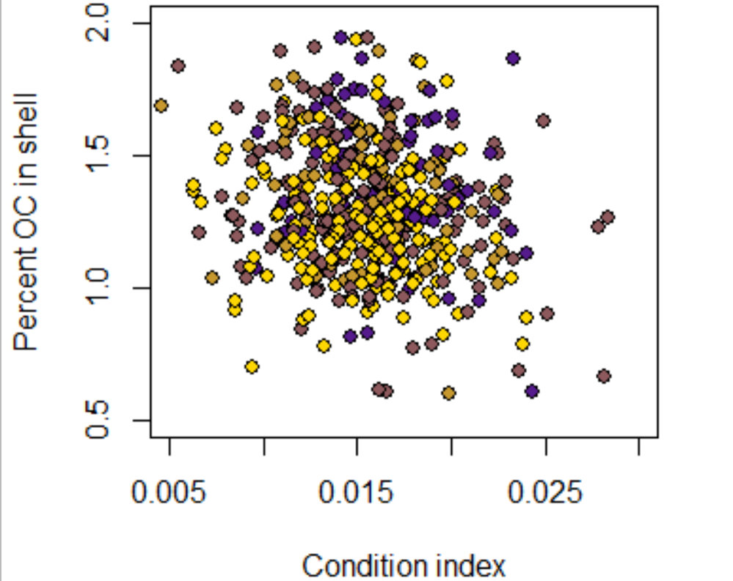
Lower condition index resulted in higher OC found in the shell; increasing TA amplified OC at a given CI
Trade off between CI vs OC
“storage” of reserves vs. “shield”?
Higher TA allows for individuals to create more resistant shells?

Slide 36
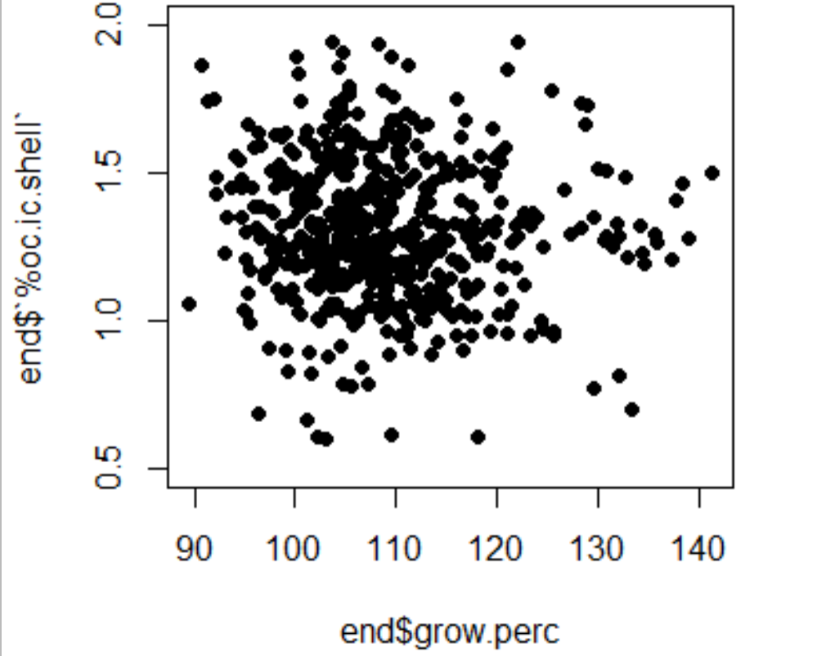
No relationship between growth and the amount of OC found in the shell
Overall growth didn’t relate to shell composition…so the surface area of the individual wasn’t related to the composition

Slide 37
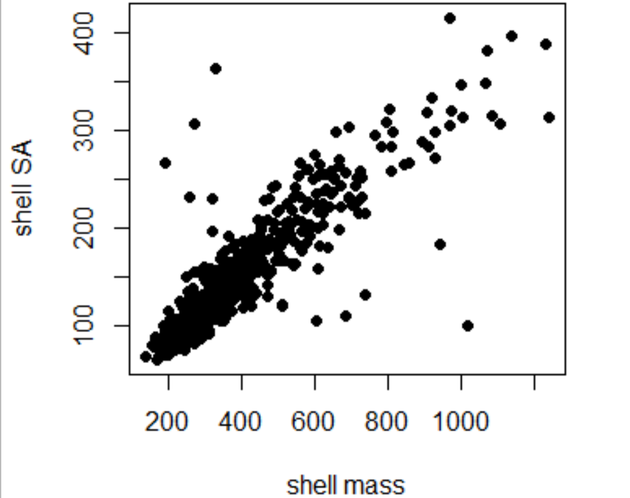
Shell mass to SA relationship was not impacted by TA or S by the last day of acclimation
Consistent with expectations
Maybe because shells were still small and OC proportion was low relative to the rest of the mass?

Slide 38
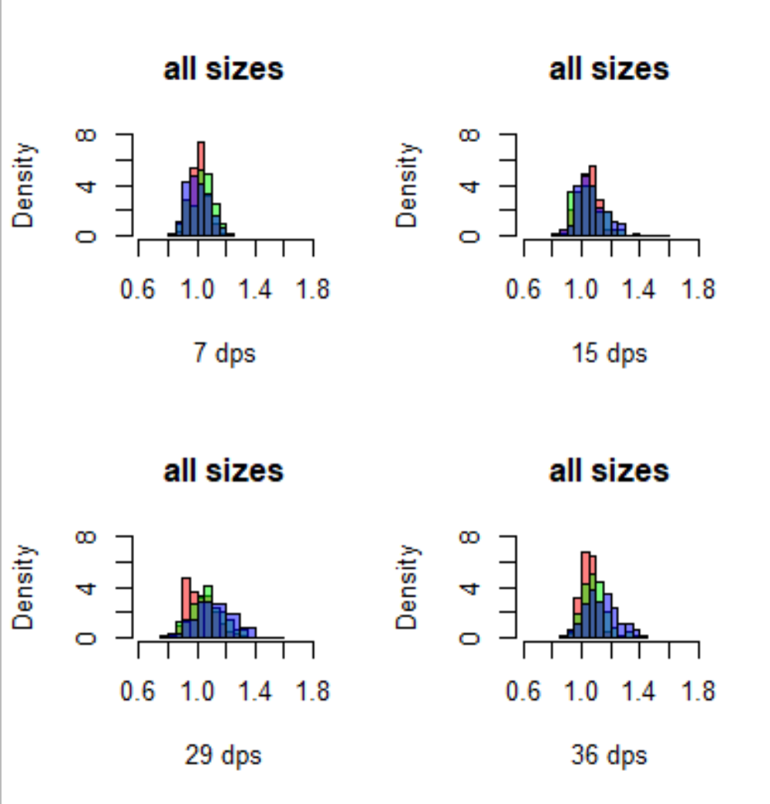
Colors by treatment: red = mid TA green = low TA blue = high TA size: ALL

Slide 39
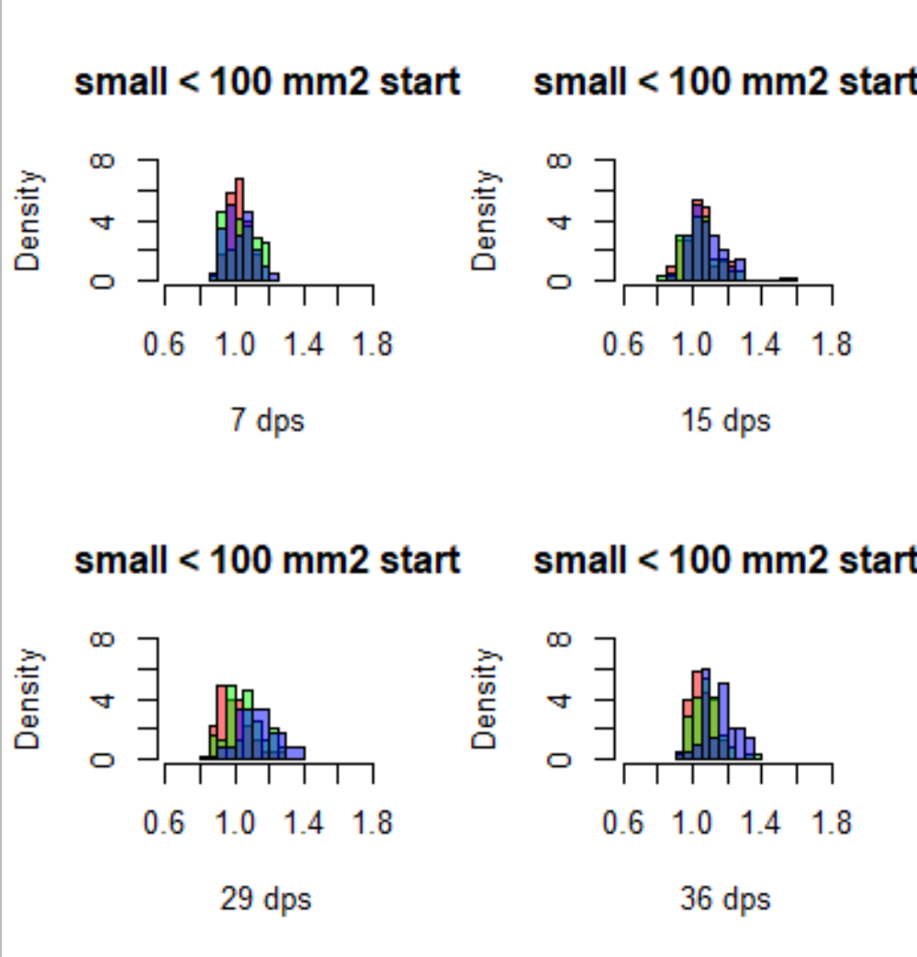
Colors by treatment: red = mid TA green = low TA blue = high TA size: SMALL

Slide 40
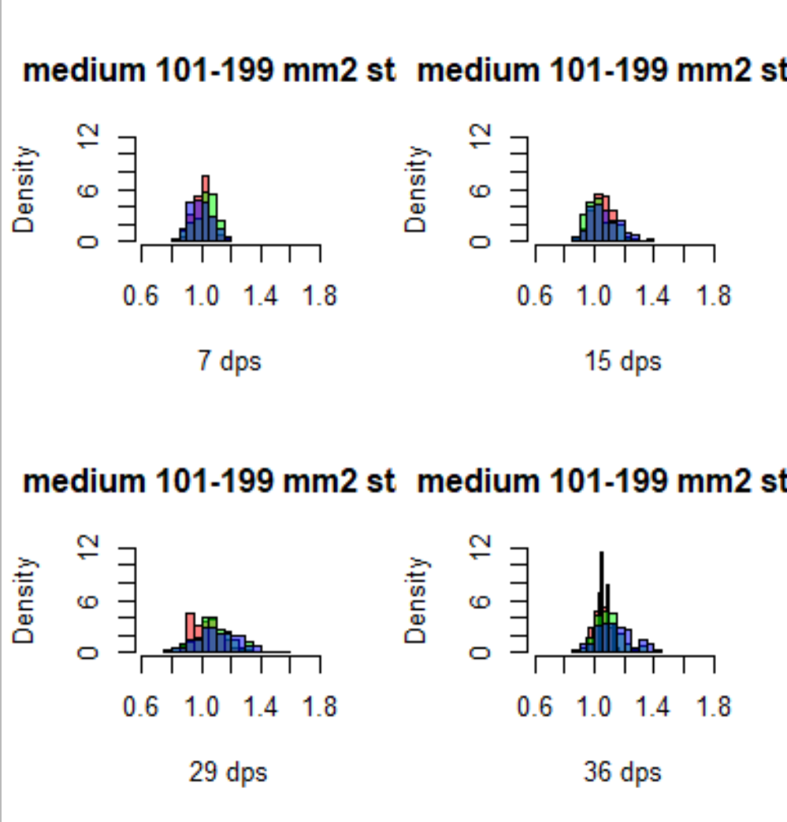
Colors by treatment: red = mid TA green = low TA blue = high TA size: MEDIUM

Slide 41
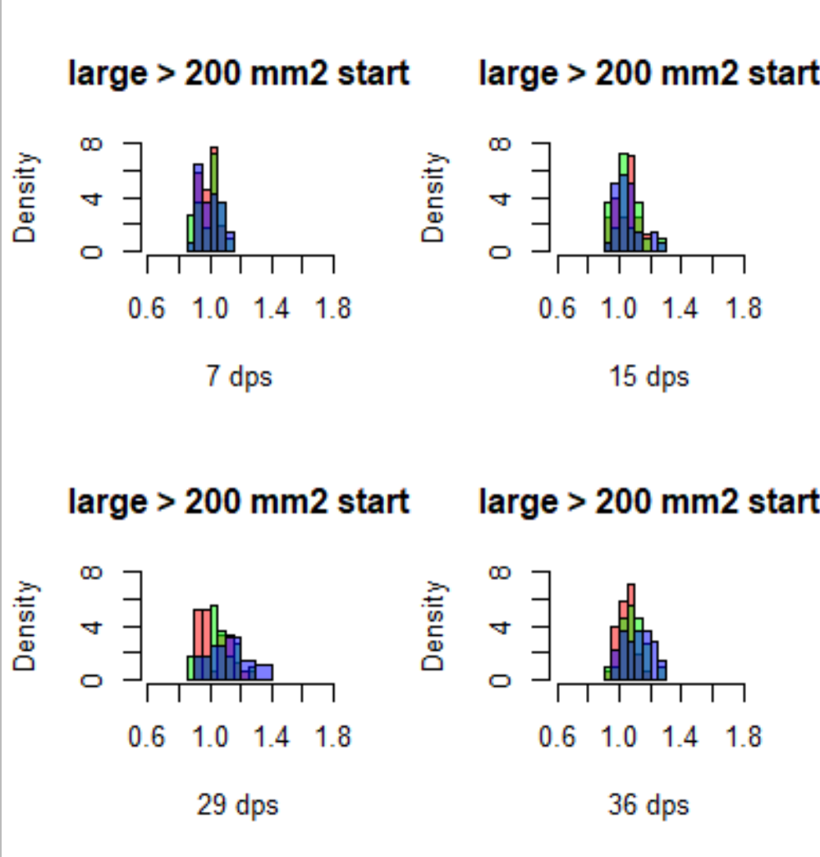
Colors by treatment: red = mid TA green = low TA blue = high TA size: LARGE

Slide 42
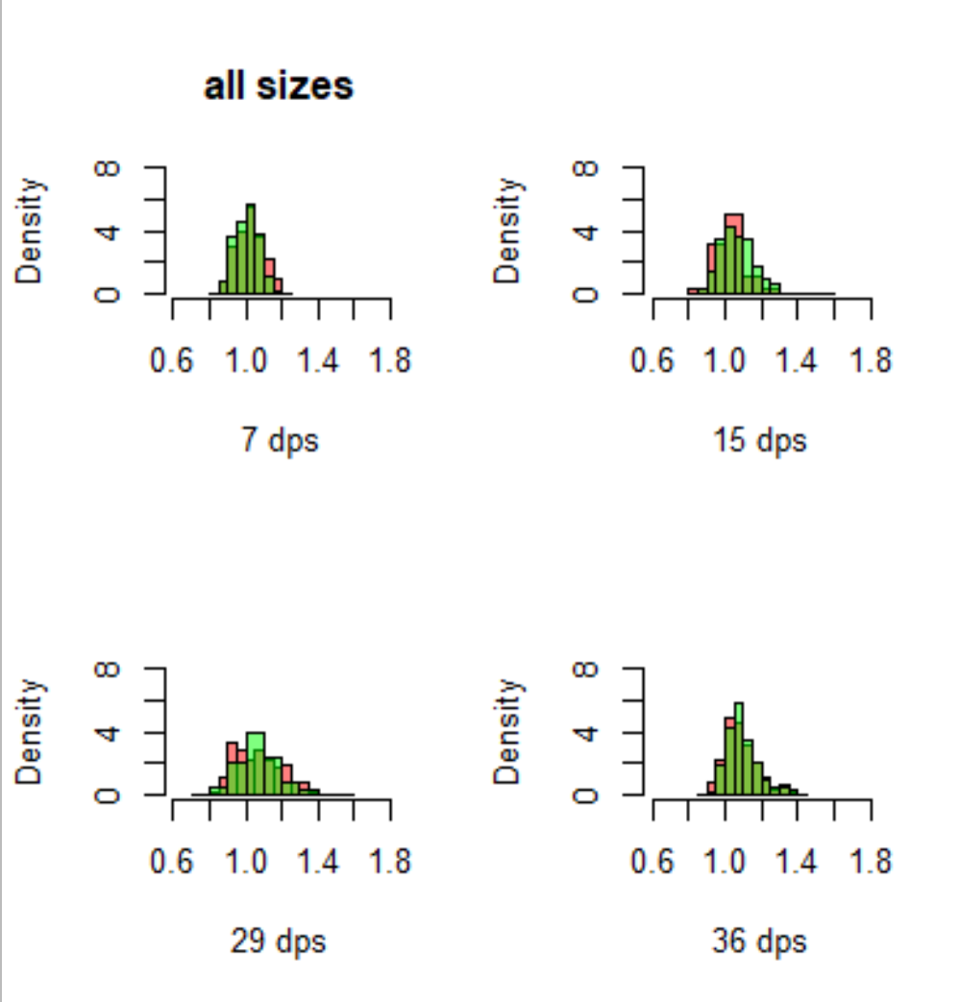
Colors by treatment: red = amb S
Green = low S size: all sizes

Slide 43
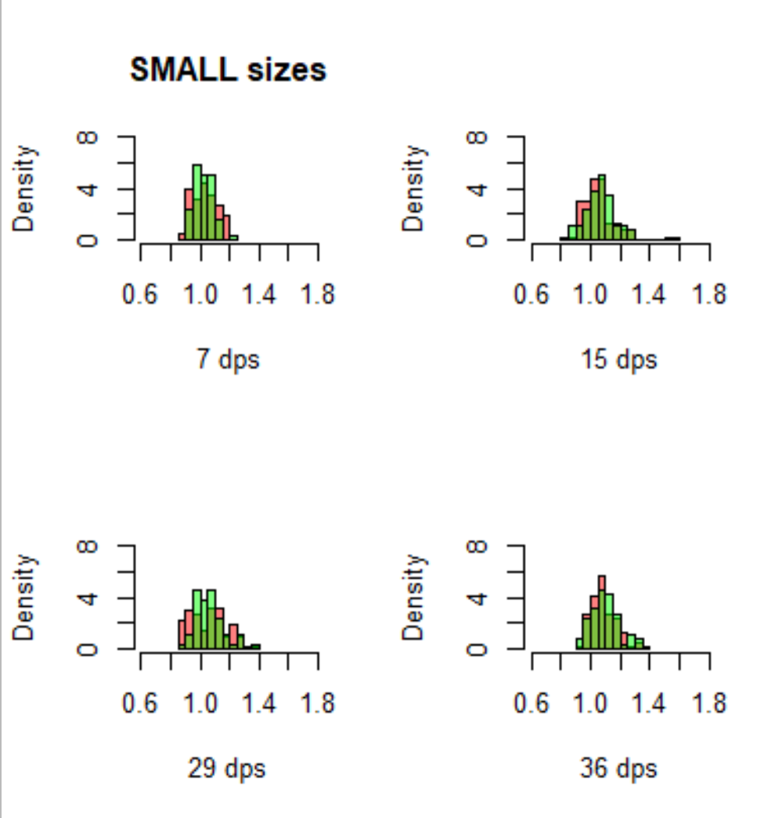
Colors by treatment: red = amb S
Green = low S size: SMALL

Slide 44
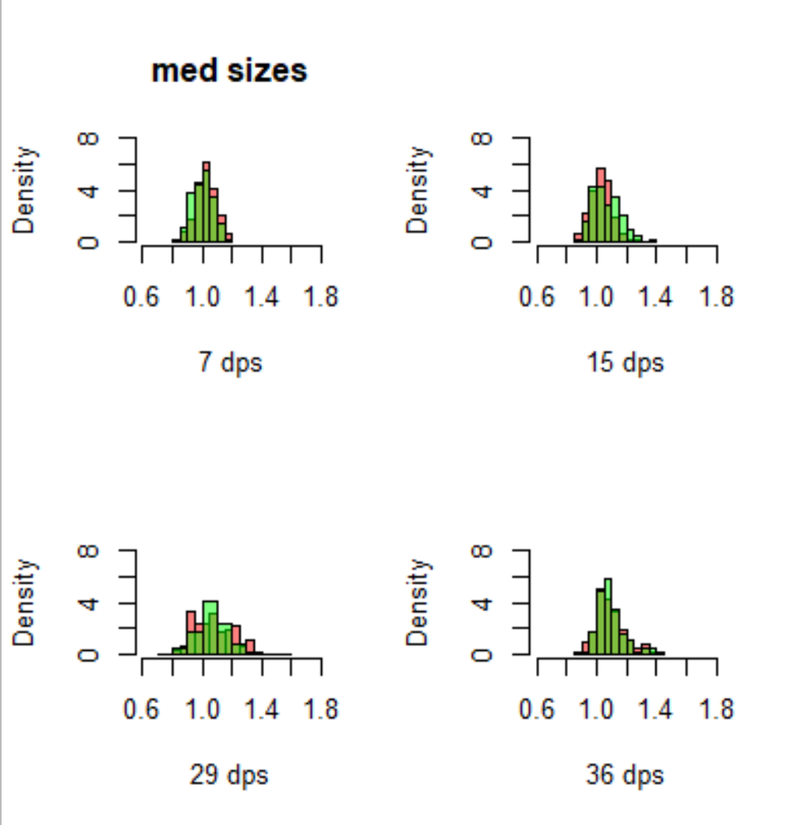
Colors by treatment: red = amb S
Green = low S size: MEDIUM

Slide 45
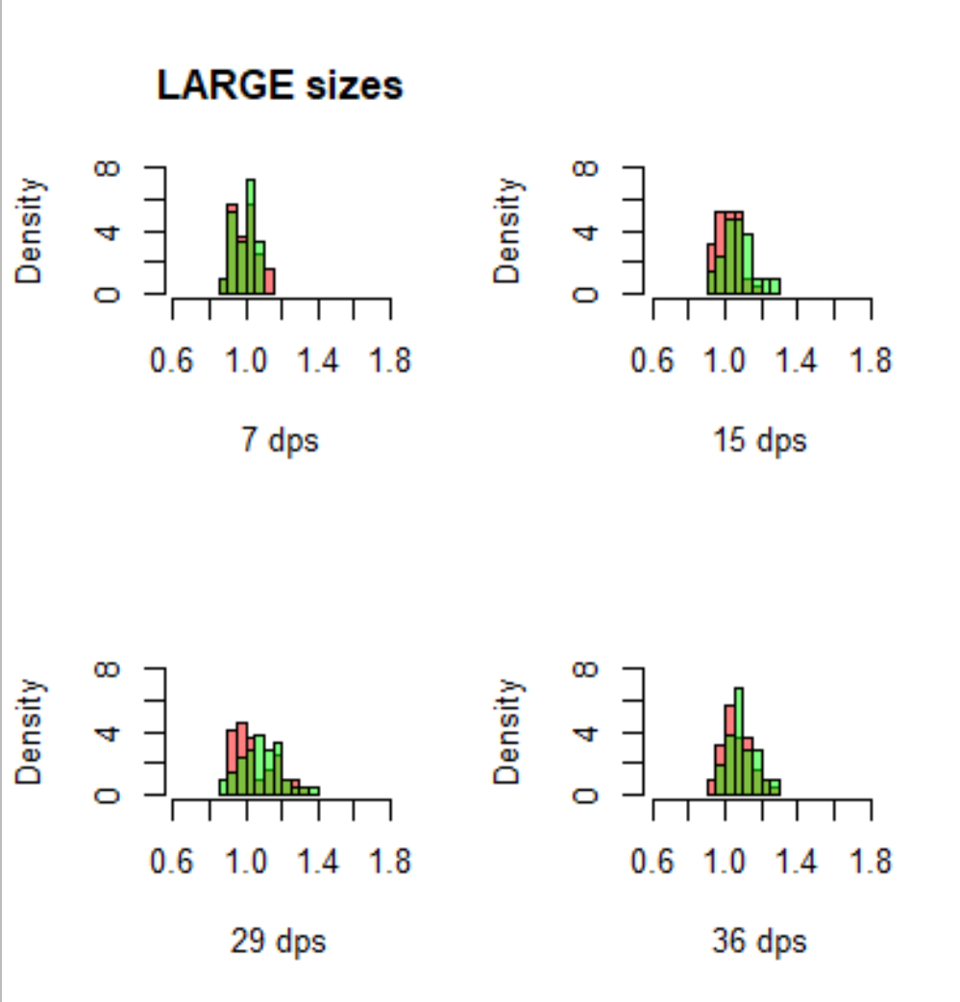
Colors by treatment: red = amb S
Green = low S size: LARGE

Slide 46
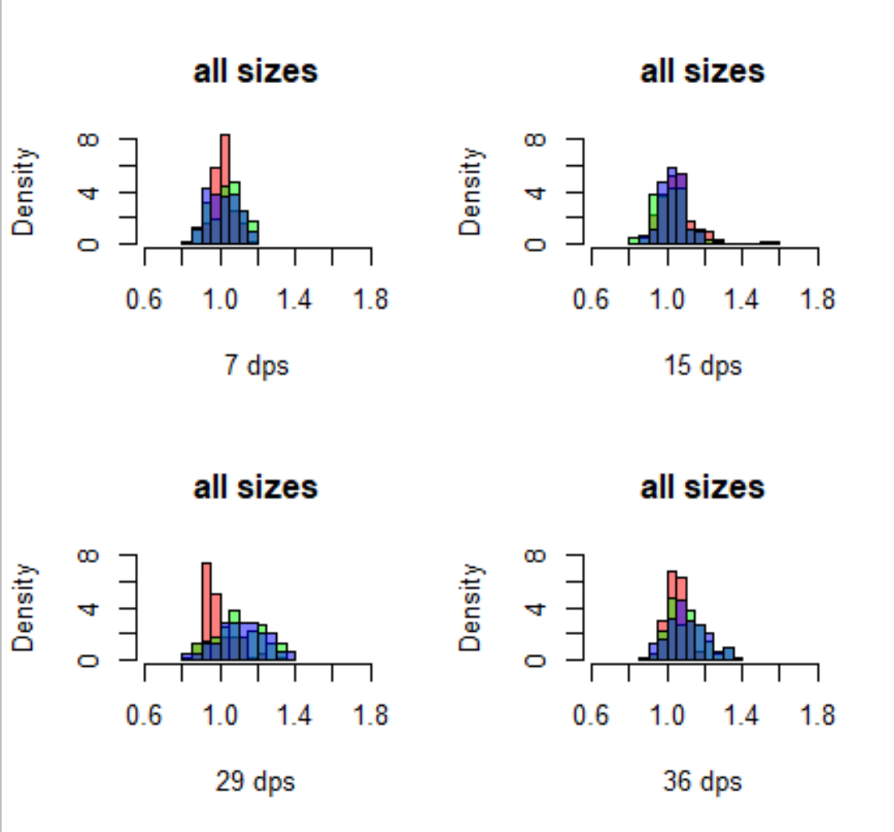
Only high S data, all sizes pooled Colors by treatment: red = mid TA green = low TA blue = high TA

Slide 47
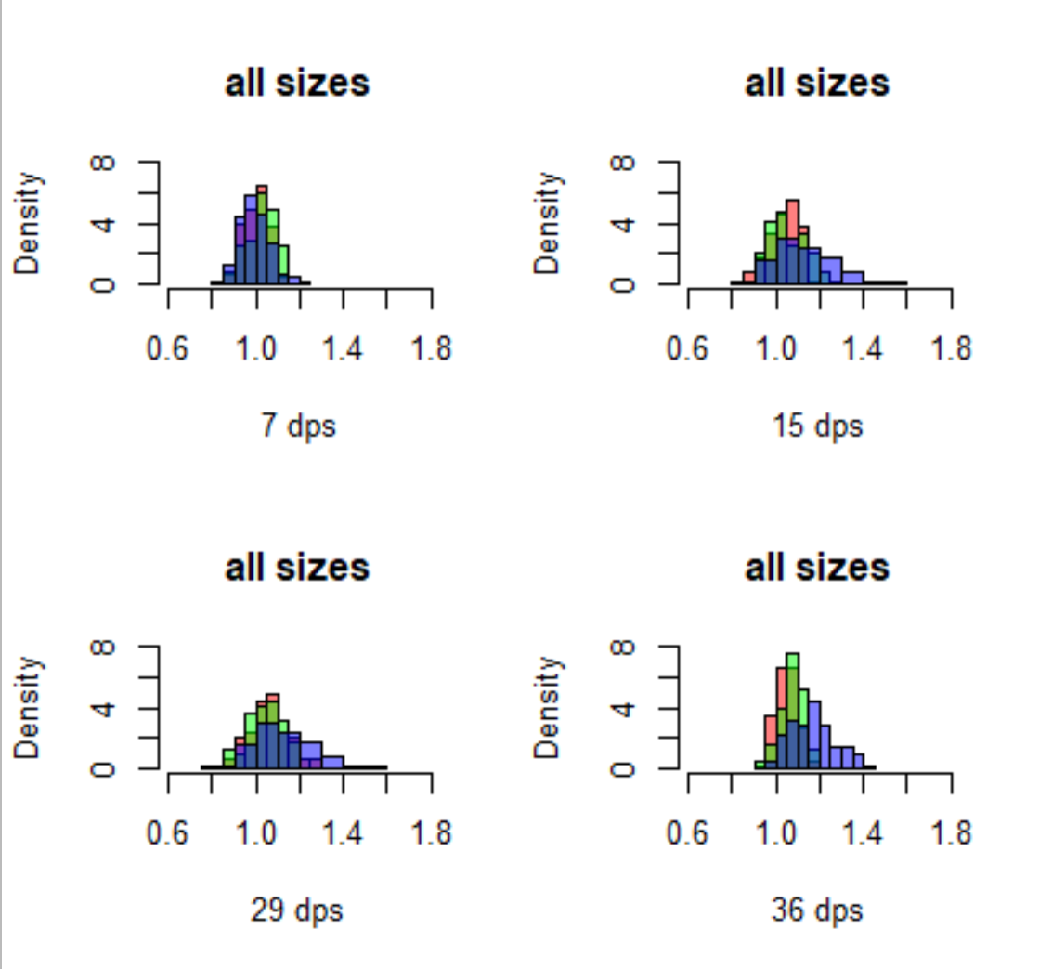
Only low S data, all sizes pooled Colors by treatment: red = mid TA green = low TA blue = high TA

Slide 48


High Salinity
36 days (dark)
15 days (light)
Low Salinity

Slide 49



High Salinity
36 days (dark)
15 days (light)
Low Salinity
3000
2000
1000
3000
2000
1000
3000
2000
1000

Slide 50


36 days (dark)
15 days (light)
High Salinity
Low Salinity
3000
2000
1000

